Slide 1
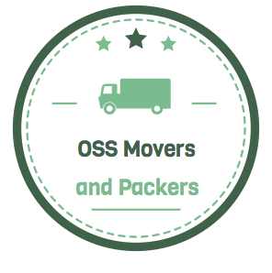
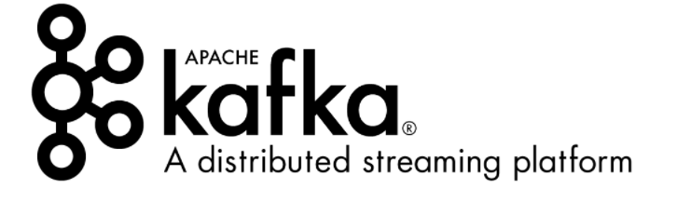

OSS Movers & Packers
For all your moving needs
Kafka inspired data streaming
Neha Goushal
Nikhil Kaushik
Nishant Singh
Parvathi Varma
Priyanka Nirpase
Tulika Mishra

Slide 2
Agenda
Who are we?
Mission
Current System
Proposed System
Business objectives
Technical Objectives
Financial Objective
Which OSS?
Why this OSS?
SDLC Model
Kafka Use cases
Kafka Sponsors
Kafka Commits
Kafka Users
User Requirements
User Persona & User Story
Risk Assessment
Risk Mitigation
Depreciation Management Policy
Project Plan
Conclusion
Group Learning goals
References

Slide 3
SECTION - I
S.No. | Topic | Slide No.
1 | Who are we? | 4-5
2 | Mission Statement | 6
3 | Company Ecosystem | 7
4 | Competitors Landscape | 8
5 | Competitors Landscape - Using Porter’s Five Forces | 9

Slide 4
Who are we?
A company started in August, 2005 that provides comprehensive business and home relocation and packing services. Our customers can leverage use our website to pre-book for the services provided by us.
Services include are Local Moving, Long-distance Moving, Packaging Services
We also sell Storage, Boxes & Supplies for packaging
Headquartered in Palo-Alto, California
We provide our services in all the 50 States of the USA
Grew to a 3500 staffed organization by 2018
Recorded a revenue of $950M in the year 2017
As of Dec, 2017, our rental fleet consists of approximately 35,000 trucks, 10,000 trailers and 4,000 towing devices

Slide 5
Who are we?
We provide a platform where truck drivers, packing service companies and tow operators can list their business and rate. We also own trucks and packaging materials.
People (consumers of these service) can login and select the movers and packers based on the rating and review as well as availability.
People can also purchase packing boxes and materials from different vendors depending on their need and specification.

Slide 6
Mission Statement
“Exceeding customers expectations!!”
Mission:
A global recognition along with an efficient working family requires us to have a strong mission. Our mission consists of elements that abide by the moral theory of business development. Thus, our mission is to achieve our vision through fairness, business ethics, global reach, technological expertise, building long term relationships with all our associates, customers, partners and employees.

Slide 7
Company Ecosystem
Suppliers: We have trusted suppliers of trucks and towing trucks.
AM General, Autocar and Chevrolet
We also have suppliers from whom we purchase the packing materials
Corrugated Cardboard Box manufacturer, Shillington box manufacturer, Walmart, Target
Customers: Truck drivers, Truck lessees and drivers.
Competitors: UHaul, United Van Lines, Two men and a truck, PODS
Target users: Data engineers, Data analysts

Slide 8
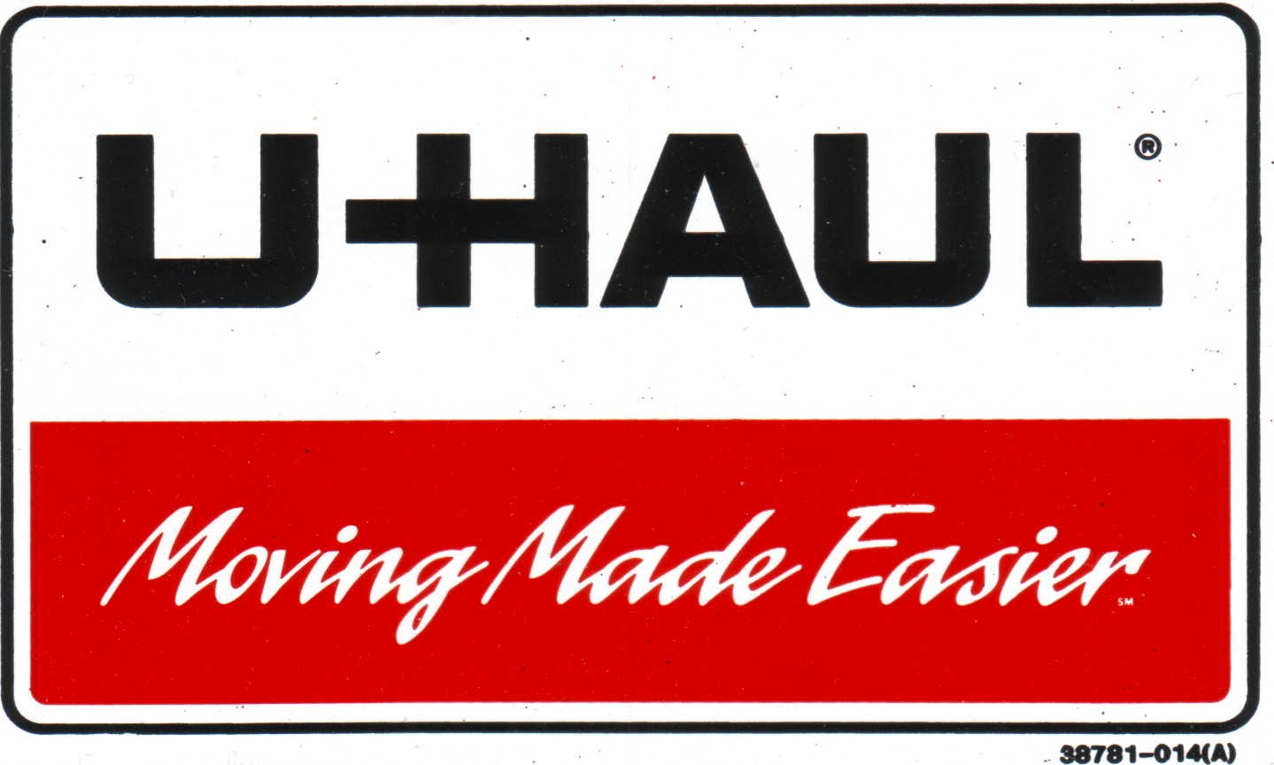



Competitor Landscape^{[37][38][39]}
Based in Phoenix, Arizona since 1945
16000 locations in United States
Number of employees: 18000
Fleet size: 150,000 trucks
Revenue: $672.8 million(2016)
Based in Lansing, Michigan since 1985
380 locations worldwide
Number of employees: 170+
Fleet size: more than 2,800 trucks
Revenue: $7.8 million(2016)
Based in Fenton, Missouri since 1928
more than 1000 agents worldwide
Number of employees: 500-1000
Fleet size: 7510 trucks
Revenue: $70.48 million
References: https://en.wikipedia.org/wiki/U-Haul[37] https://twomenandatruck.com/[38] https://en.wikipedia.org/wiki/United_Van_Lines[39]
Notes:
References:
https://en.wikipedia.org/wiki/U-Haul[37]
https://en.wikipedia.org/wiki/United_Van_Lines[38]
https://twomenandatruck.com/[39]

Slide 9
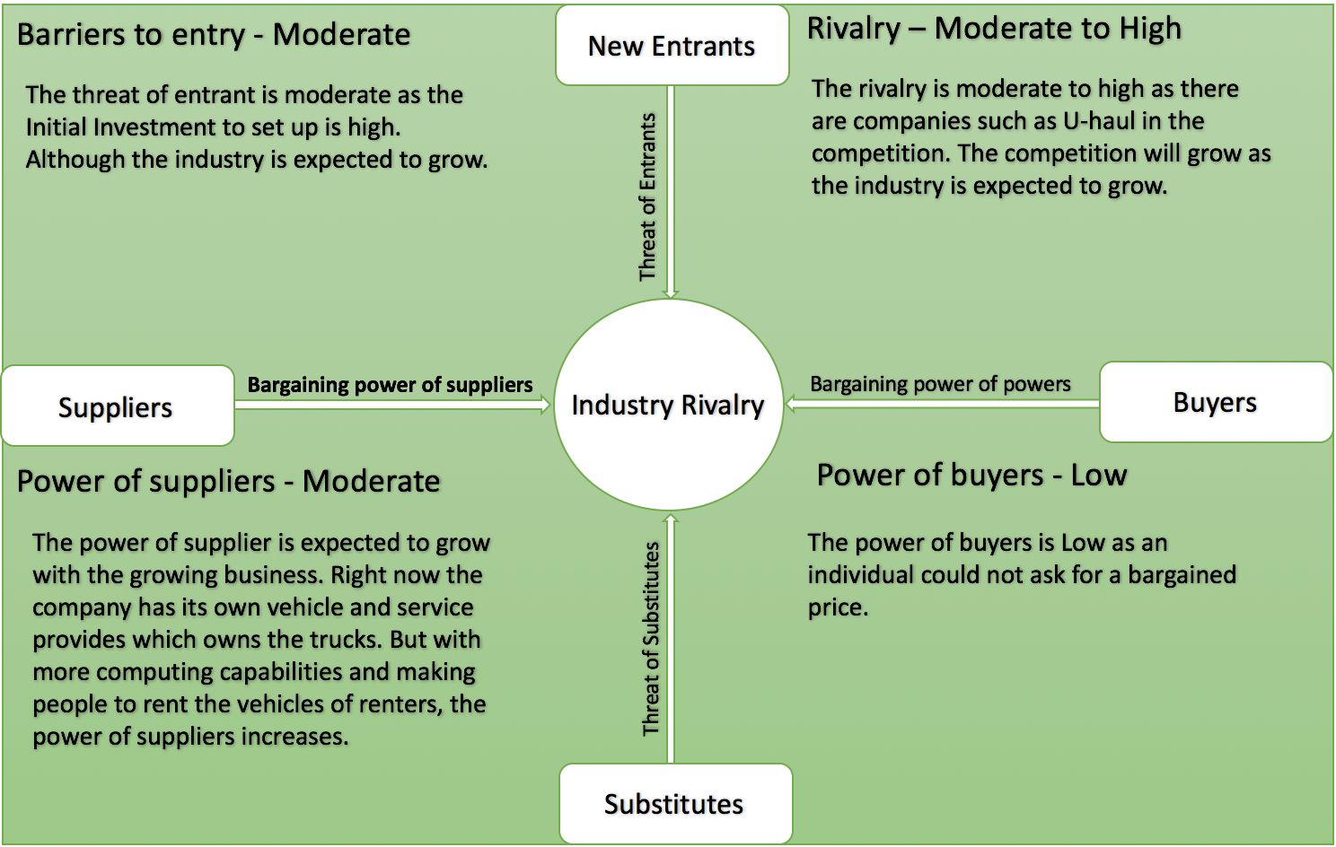
Competitors Landscape - Porter’s Five Forces^{[33]}
References: https://www.mindtools.com/pages/article/newTMC_08.htm[[33]
Notes:
https://www.mindtools.com/pages/article/newTMC_08.htm[33]
http://clients1.ibisworld.com/reports/us/industry/default.aspx?entid=1366[32]

Slide 10
SECTION - II
S.No. | Topic | Slide No.
1 | Requirement Summary | 11
2 | Measurements for the problem | 12
3 | Current System - Technical | 13
4 | Current System Flow Diagram | 14
5 | Challenges in Current System | 15
6 | Proposed System | 16
7 | Proposed System Architecture | 17
8 | Which OSS | 19
9 | OSS Capabilities | 20
10 | Kafka Ecosystem | 21
11 | OSS Ecosystem | 22
12 | About Kafka | 23-35

Slide 11
Requirement Summary
Current System:
We have a traditional ETL with current Hadoop ecosystem. Data is handled in big batches with no capability to handle real-time data.
Competitors’ current system:
Batch processing in traditional ETL
Challenges of current system:
Limitation on scaling
Big batch processing which makes analytical operations to wait till the batches are loaded
Not able to handle real-time data
Processes like price and inventory adjustments need real time data processing.

Slide 12
Measurements for the problem
Big Data→ Volume, Variety, value and velocity of data
Type of data: Customer orders, price history, inventory, sales, products, customer behavior, user reviews, customer profiles, discounts, click rates etc.
1 Million rows in dimension tables, size- 50GB
Total data volume each day loaded by ETL into the data warehouse from all source systems: 15 GB
Size of Fact tables - 30 TB
Volume of the periodic snapshot fact tables - 3 TB
5-6 source data systems
Notes:
This is an overview of the data that we currently deal with.

Slide 13
Current System - Technical
We have a website which has been implemented in Spring, handing the MVC logic.
The data storage and extraction is done in multiple databases such as PostgreSQL, MySQl, Oracle
Datastores holds data coming from source systems such as transactional data, supply chain management and inventory management
Datastores feed the data into Data Warehouse
The whole system is integrated to Hadoop and Analytical applications

Slide 14
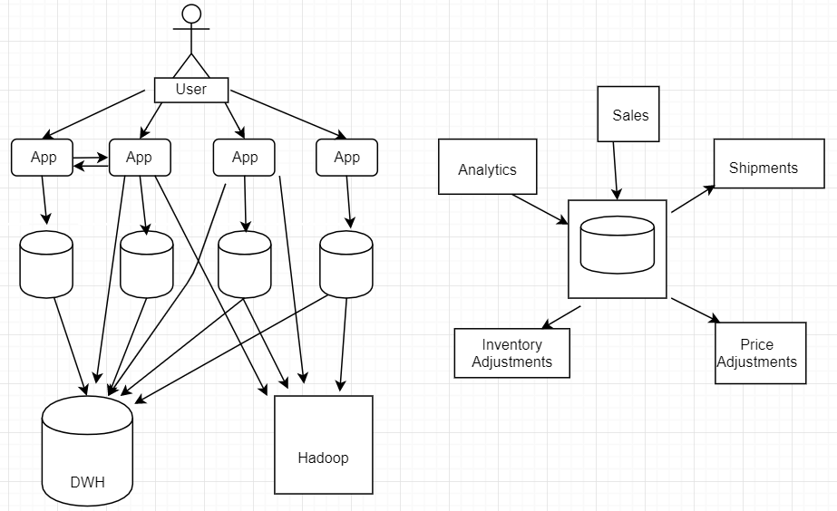
Current System Flow Diagram
DWH
DS
DS
DS
DS
Diagrams: Created by team

Slide 15
Challenges in Current System
Initially we went with a low-level data model for our business, where our use cases were simple and clearly defined over the time as the business grew, complexity of the system increased.
Centralized database - databases are increasing as the business is growing
Limitation on scaling in current Hadoop ecosystem and traditional ETL
Not able to handle real-time data
Big batch processing
Processes like price and inventory adjustments need real time data processing.
Notes:
We initially developed several different custom data pipelines for our various streaming and queuing data. The use cases for these platforms ranged from tracking site events like page views to gathering aggregated logs from other services. Other pipelines provided queuing functionality for our InMail messaging system, etc. These needed to scale along with the site. Rather than maintaining and scaling each pipeline individually, we invested in the development of a single, distributed pub-sub platform
https://insidebigdata.com/2016/04/28/a-brief-history-of-kafka-linkedins-messaging-platform/
In today’s world bulk and batch loading remain the most common method. More advanced data warehouse technologies are moving to continuous loading methods, which means that data is being loading from operational sources in real-time. This enables you to ingest stream data and perform updates for read optimization.
Reference: https://www.cooladata.com/blog/business-problems-solved-by-data-science/

Slide 16
Proposed System
Need a sophisticated data pipeline which can scale quickly
Highly efficient to move data around whole data pipeline
Real-time streaming platform for processing data like sales, price, inventory, customer experiences, shipments, system crash, etc.
Integrate with analytical applications for better decision making

Slide 17
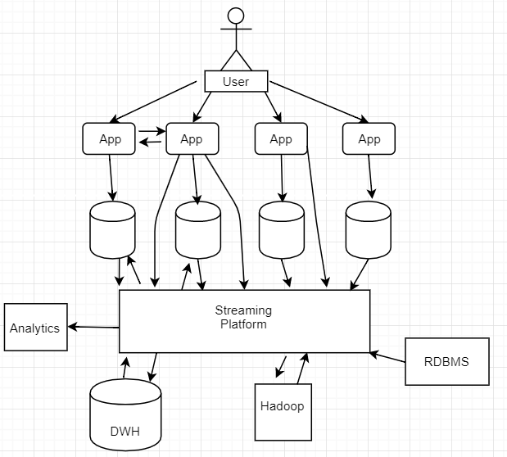
Proposed System Architecture
DS
DS
DS
DS
(Kafka )
Diagram: Created by team

Slide 18

About

Slide 19
Which OSS?
Apache Kafka® is an open-source stream processing platform developed by the Apache Software Foundation written in Scala and Java.^{[6]}
History: Apache Kafka® was originally developed by LinkedIn, and was subsequently open sourced in early 2011. ^{[6]}
Features: Kafka® provide a unified, high-throughput, low-latency platform for handling real-time data feeds. Its storage layer is essentially a "massively scalable pub/sub message queue architected as a distributed transaction log," making it highly valuable for enterprise infrastructures to process streaming data.^{[7]}
Applications: Kafka® works as messaging bus, helps in tracking website activities, monitoring data, used as log aggregation solution, in event sourcing and acts as external commit-log for a distributed system ^{[7]}
Reference: https://en.wikipedia.org/wiki/Apache_Kafka [6]
https://kafka.apache.org/uses [7]
Notes:
Reference: https://en.wikipedia.org/wiki/Apache_Kafka[6]
https://kafka.apache.org/uses[7]

Slide 20
OSS Capabilities
High-throughput: Kafka® is capable of handling high-velocity and high-volume data using not so large hardware. It is capable of supporting message throughput of thousands of messages per second.^{[8]}
Low latency: Kafka® is able to handle these messages with very low latency of the range of milliseconds, demanded by most of new use cases.^{[8]}
Fault tolerant: The inherent capability of Kafka to be resistant to node/machine failure within a cluster.^{[8]}
Highly scalable: Kafka® is a distributed system, which is able to be scaled quickly and easily without incurring any downtime.^{[8]}
Highly durable: Kafka® persists the messages on the disks, which provides intra-cluster replication. This makes for a highly durable messaging system.^{[8]}
Reference: http://blog.syncsort.com/2016/05/big-data/4-benefits-of-using-apache-kafka-in-lieu-of-amqp-or-jms/ [8]
Notes:
Reference: http://blog.syncsort.com/2016/05/big-data/4-benefits-of-using-apache-kafka-in-lieu-of-amqp-or-jms/[8]

Slide 21
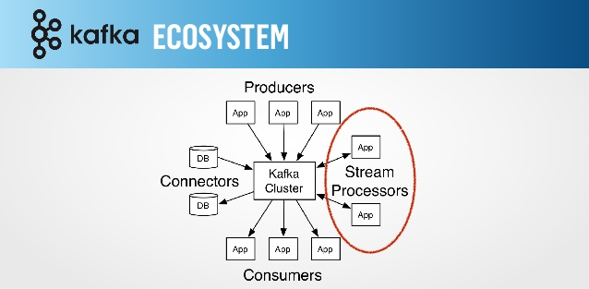
Kafka Ecosystem^{[10]}
Reference: https://cwiki.apache.org/confluence/display/KAFKA/Ecosystem[10]
Notes:
https://cwiki.apache.org/confluence/display/KAFKA/Ecosystem[10]

Slide 22
OSS Ecosystem
Open framework, unified, high-throughput, low-latency platform
7 years old ^{[12]}
Cross-platform operating system ^{[12]}
6,000+ citations, 370+ contributors, 7000+ stars ^{[12]}
4000+ forks, >1 pull request / day average ^{[12]}
60 Sponsors ^{[12]}
Latest stable version was released 2 months ago ^{[12]}
Can handle huge amount of data ^{[12]}
References: https://kafka.apache.org/ [12]
Notes:
https://kafka.apache.org/ [12]

Slide 23

Leverage Apache Kafka®
Real-time streaming platform^{[1]}
Can handle 20 millions of events like user activity, click rates, orders, etc^{[1]}
Need for analyzing these events to determine KPIs
Better decision making
Easily integrated with analytical applications
Reference : https://kafka.apache.org/[1]
Notes:
Reference : https://kafka.apache.org/ [1]

Slide 24
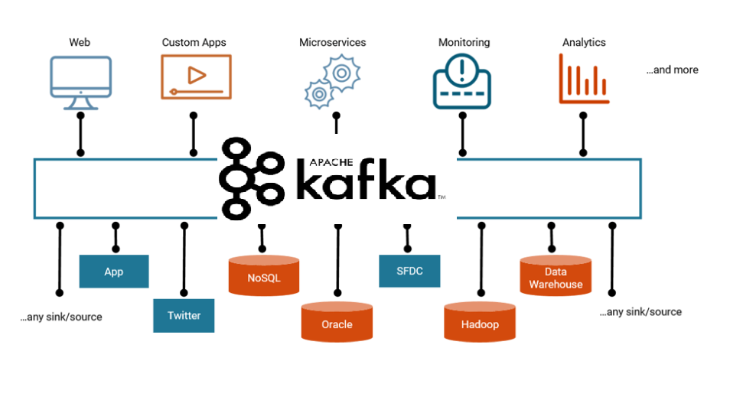
Sophisticated data pipeline^{[2]}
Reference: https://www.confluent.io/blog/the-future-of-etl-isnt-what-it-used-to-be/ [2]
Notes:
Reference: https://www.confluent.io/blog/the-future-of-etl-isnt-what-it-used-to-be/[2]

Slide 25
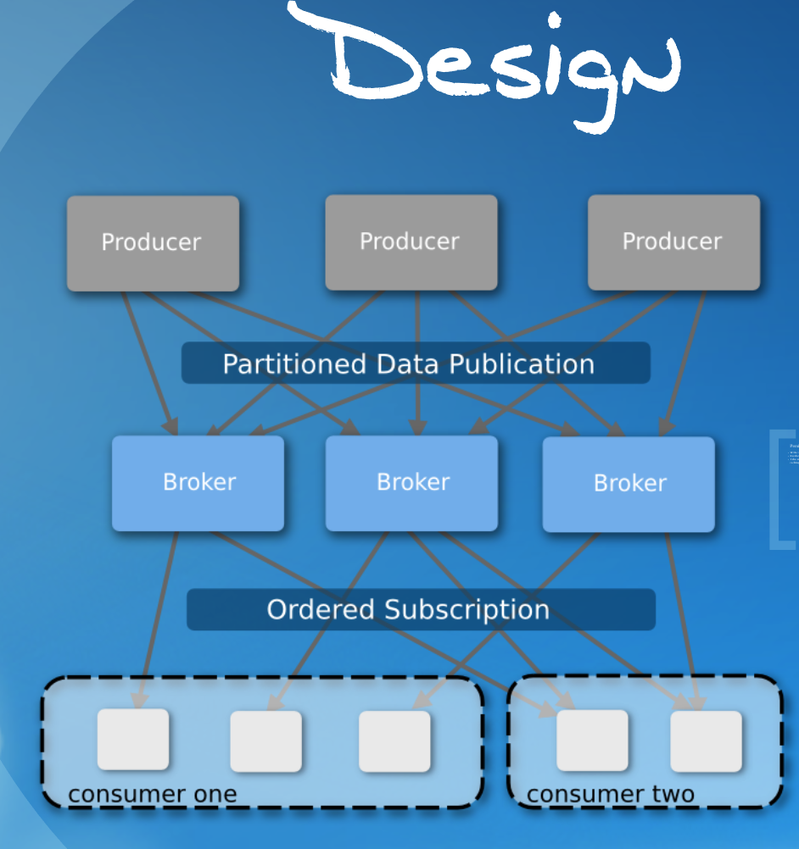
Design of Kafka^{[40]}
Reference: https://prezi.com/mxenutdbqzij/sdec-2012-apache-kafka/[40]
Notes:
Reference: https://prezi.com/mxenutdbqzij/sdec-2012-apache-kafka/[40]

Slide 26
OSS technical functionality
Producer:
An application that pushes data to Kafka
data can be anything like text, numbers or an entire row of a table^{[41]}
various APIs are: rest, java, c++^{[41]}
batch messages to reduce overhead
compress batched events to lower network bandwidth, disk write resources, at the cost of a few cpu cycles
Reference: https://prezi.com/mxenutdbqzij/sdec-2012-apache-kafka/[41]
Notes:
Reference: https://prezi.com/mxenutdbqzij/sdec-2012-apache-kafka/[41]

Slide 27
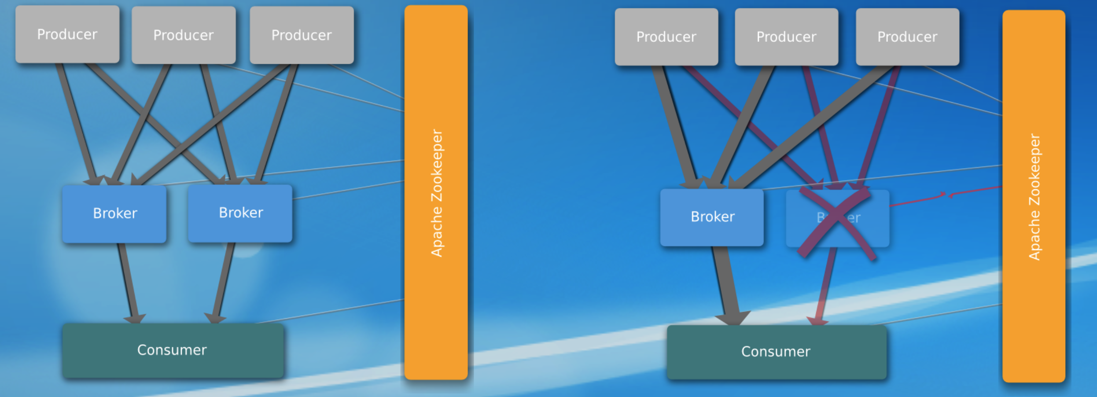
OSS technical functionality
Broker
Use Zookeeper to keep track of brokers^{[42]}
Zookeeper can detect Node Failures
Reference: https://prezi.com/mxenutdbqzij/sdec-2012-apache-kafka[42]/
Notes:
Reference: https://prezi.com/mxenutdbqzij/sdec-2012-apache-kafka/[42]

Slide 28
OSS technical functionality
Consumer:
An application that pulls data from Kafka
Consumer handles the management part as well
Data is ordered across each partition but not across multiple partitions^{[43]}
uses Zookeeper to store offsets for each node and partition
Consumer needs 4 attributes to pull data from broker-^{[43]}
Broker location (Node Id, IP address)
Topic Name (item views)
Partition # (Partition 1, Partition 2, etc.)
Offset into data
References: https://prezi.com/mxenutdbqzij/sdec-2012-apache-kafka/
Notes:
Reference: https://prezi.com/mxenutdbqzij/sdec-2012-apache-kafka/[43]

Slide 29

Upstream and Downstream
Upstream:
Apache Software Foundation, Scala, HBase, HDFS, Java, Zookeeper ^{[13]}
Downstream:
Kafka Connect : Kafka Connect is a framework included in Apache Kafka that integrates Kafka with other systems. Its purpose is to make it easy to add new systems to your scalable and secure stream data pipelines. ^{[13]}
Apache Samza : Apache Samza is a distributed stream processing framework. It uses Apache Kafka for messaging. ^{[13]}
Reference: https://www.confluent.io/[13]
Notes:
Reference: https://www.confluent.io/[13]

Slide 30
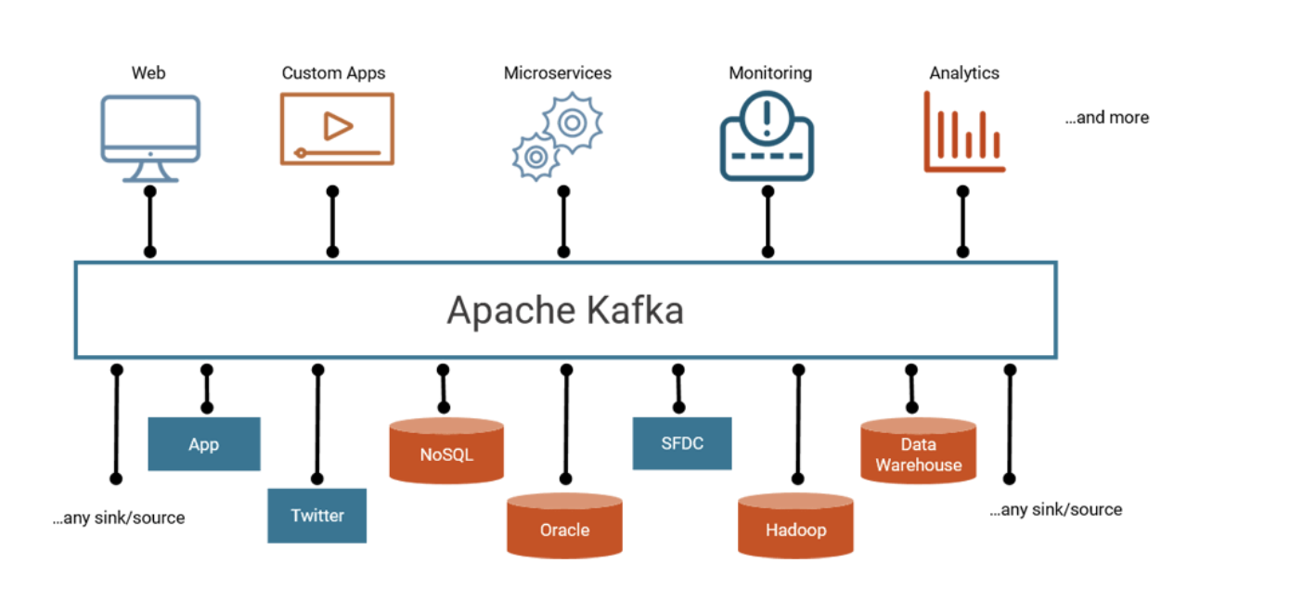
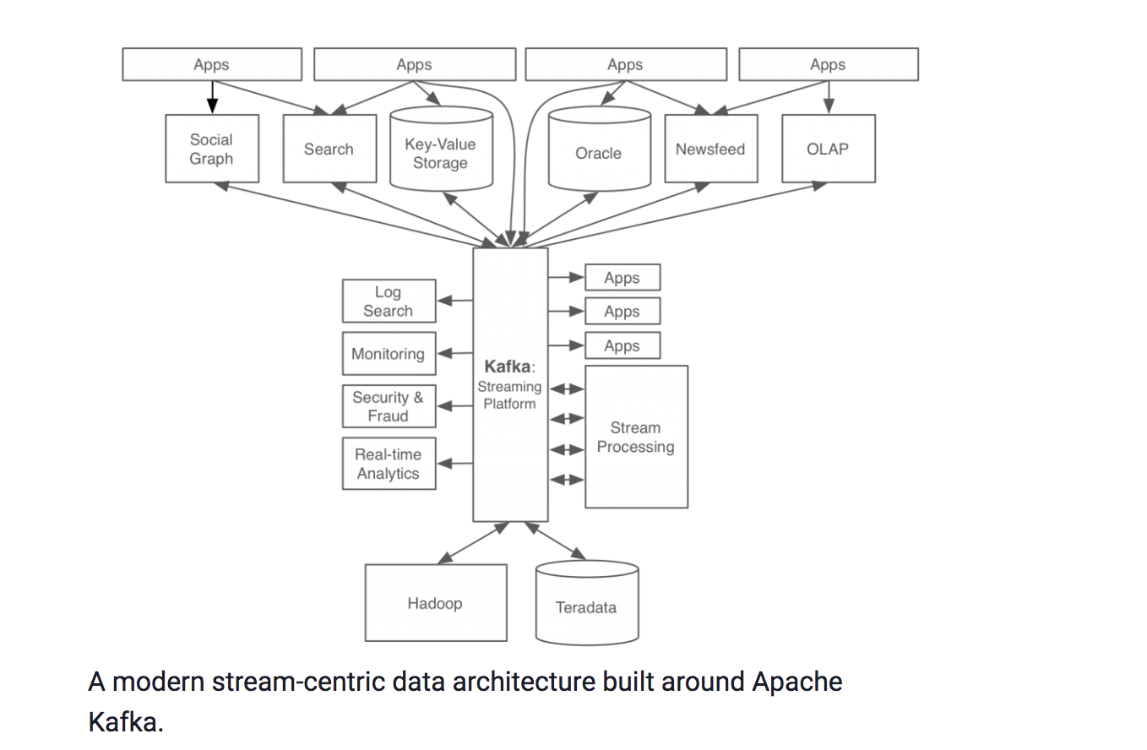
Kafka Use Cases ^{[14][15]}
Reference: https://www.confluent.io/blog/the-future-of-etl-isnt-what-it-used-to-be/, [14]
https://www.confluent.io/blog/stream-data-platform-1/ [15]
Notes:
https://www.confluent.io/blog/the-future-of-etl-isnt-what-it-used-to-be/[14]
https://www.confluent.io/blog/stream-data-platform-1/[15]

Slide 31
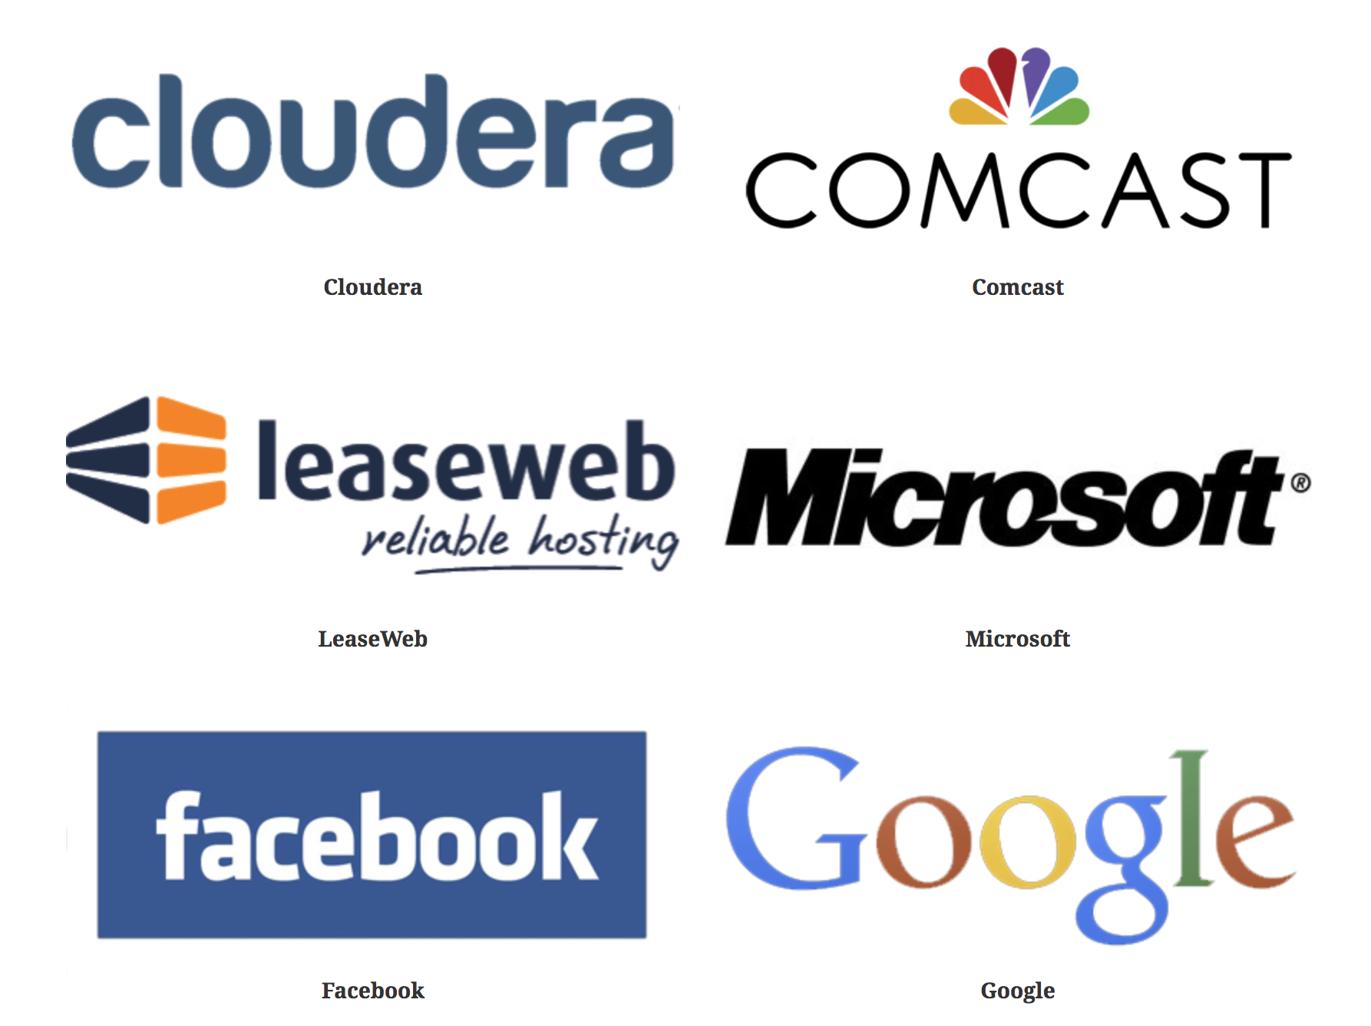
Kafka Sponsors - Platinum Members ^{[16]}
Reference: http://www.apache.org/foundation/thanks.html [16]
Notes:
Reference: http://www.apache.org/foundation/thanks.html[16]

Slide 32
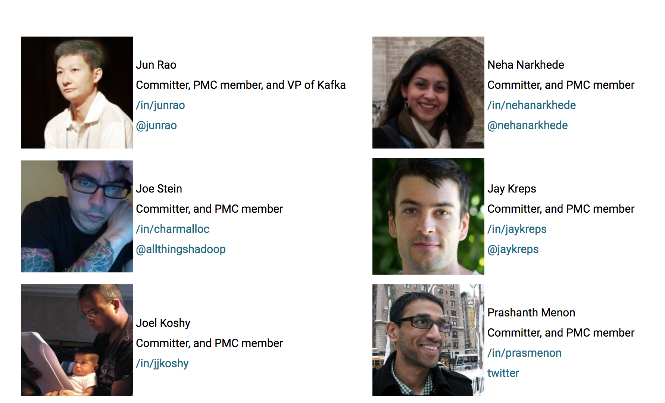
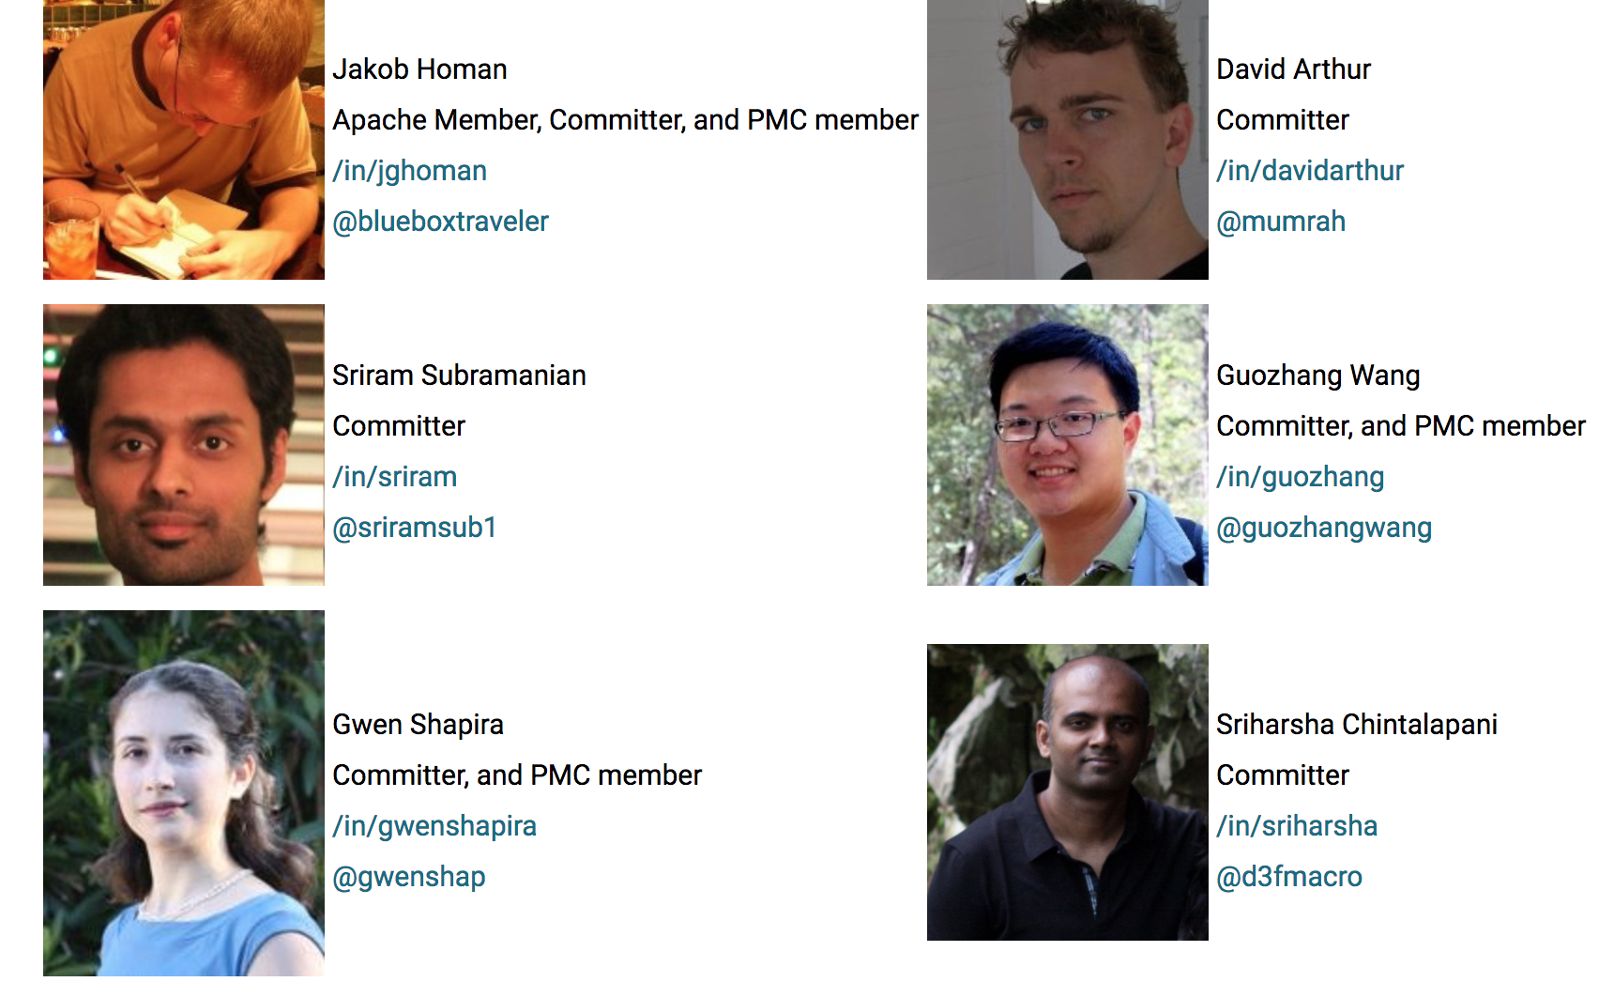
Kafka has 21 Committers ^{[17][18]}
Reference: https://en.wikipedia.org/wiki/Committer [17]
https://kafka.apache.org/committers [18]
Notes:
“A committer is an individual who is able to modify the source code of a particular piece of open-source software.”
Reference: https://en.wikipedia.org/wiki/Committer[17]
https://kafka.apache.org/committers[18]

Slide 33
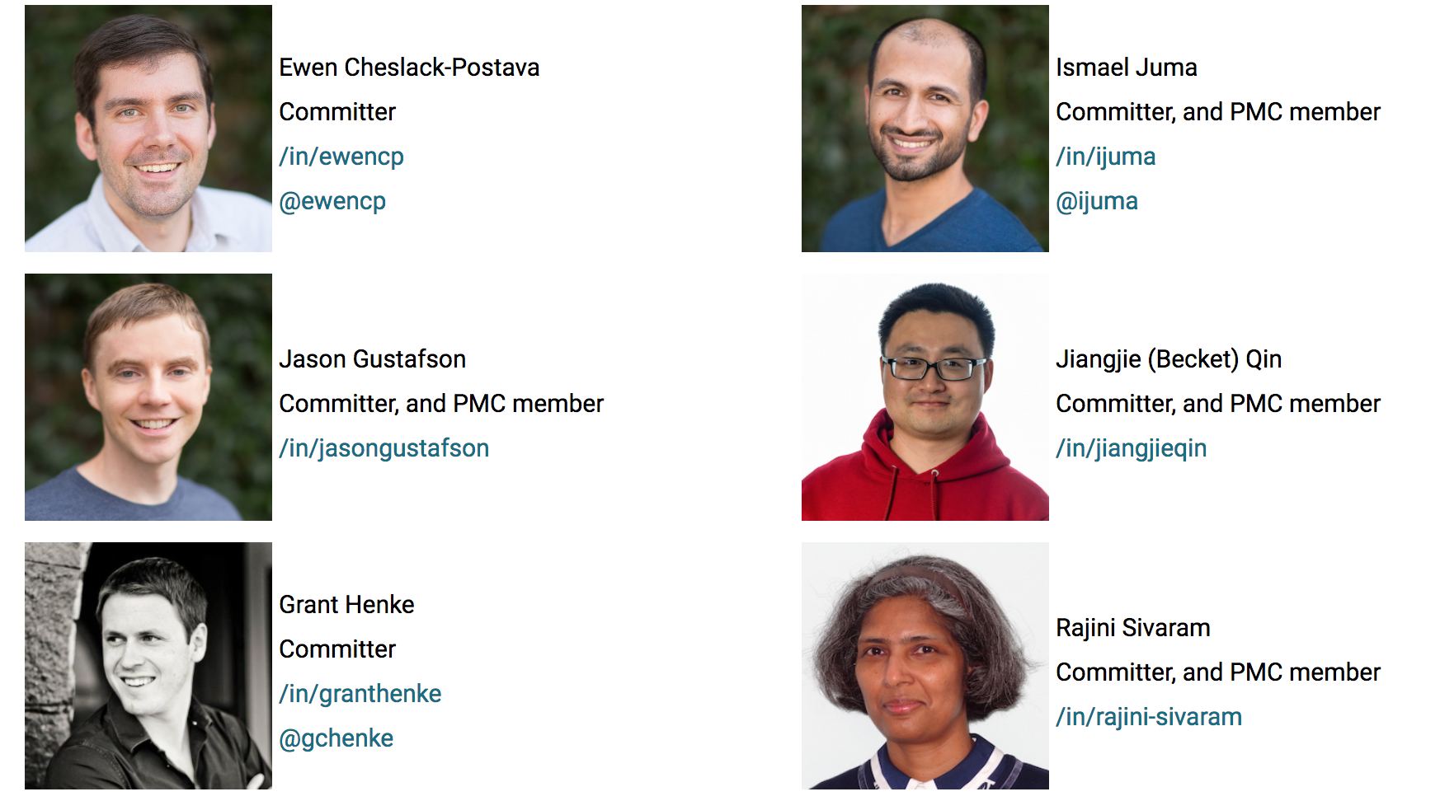
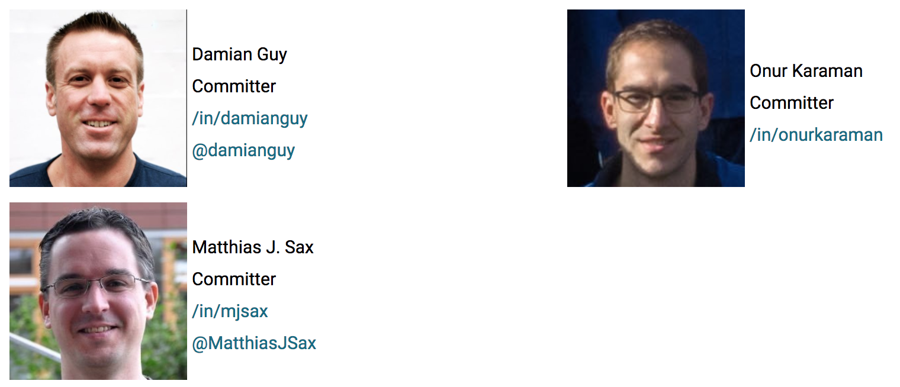
Kafka Committers Contd.. ^{[19][20]}
Reference: https://en.wikipedia.org/wiki/Committer[19]
https://kafka.apache.org/committers [20]
Notes:
Reference: https://en.wikipedia.org/wiki/Committer [19]
https://kafka.apache.org/committers [20]

Slide 34
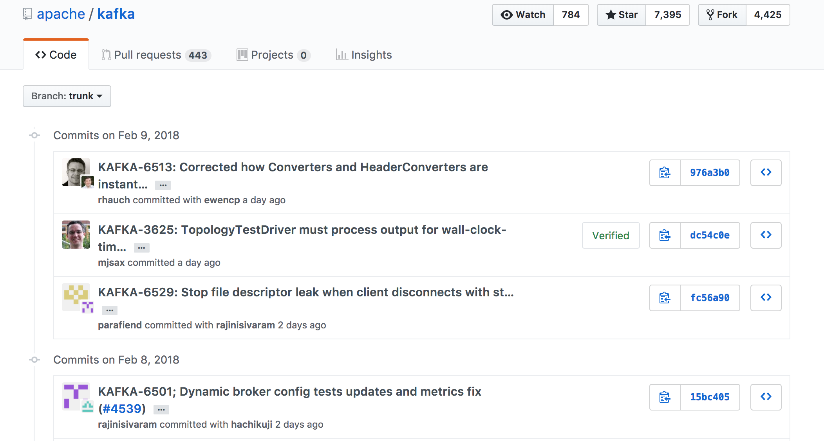
Kafka Active Commits ^{[21]}
Reference: https://github.com/apache/kafka/commits/trunk [21]
Notes:
Reference: https://github.com/apache/kafka/commits/trunk[21]
We are observing commits on a daily basis on Kafka Github.

Slide 35
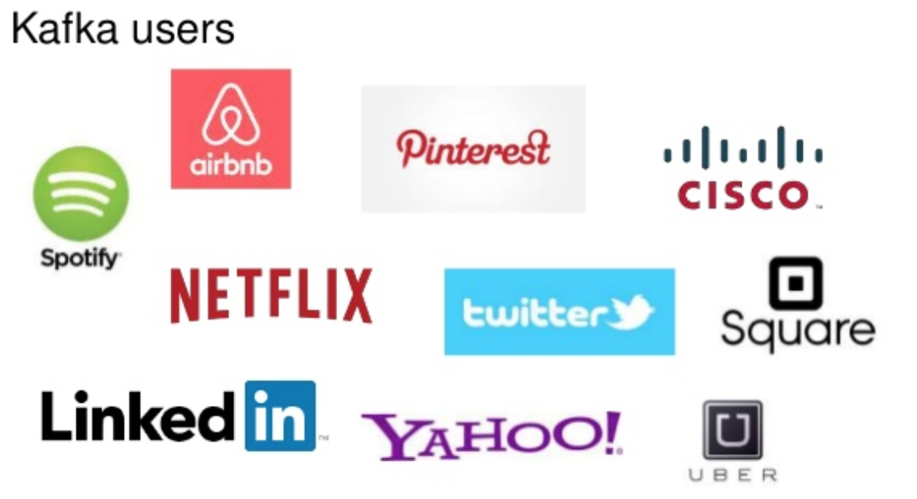
Kafka Users ^{[22]}
Reference: https://kafka-summit.org/kafka-summit-sf/sponsors/ [22]
Notes:
Reference: https://kafka-summit.org/kafka-summit-sf/sponsors/[22]

Slide 36
SECTION - III
S.No. | Topic | Slide No.
1 | Business Objectives | 37
2 | Technical Objectives | 38
3 | Financial Objectives | 39
4 | Political Objective | 40
5 | Business Owners objective | 41
6 | Benefit from OSS for each class | 42
7 | OSS - Return on Investment | 43-45
8 | Project - Return On Investment | 46-48
9 | Data for ROI Calculation | 49-54

Slide 37
Business Objectives
Offer an ideal relocation and packaging service application that can handle 10 million customer requests in real-time^{[3]}
Build an application that is capable of handling various types of data like customer requests, order shipments, inventory data, sales, products etc. without any latencies^{[3]}
Fill the gap in data infrastructure by choosing Kafka as the main engine underneath and write our own library to facilitate application developers^{[3]}
Increase the flexibility to adapt to new business requirements as the company is growing as well as the number of requests per customer.
Business Optimization by switching to a real-time based approach.
Reference: https://www.confluent.io/press-release/survey-apache-kafka-users-highlights-impact-streaming-data-global-businesses/ [3]
Notes:
Reference: https://www.confluent.io/press-release/survey-apache-kafka-users-highlights-impact-streaming-data-global-businesses/ [3]
Using kafka logs to keep track of customer order history

Slide 38
Technical Objectives
To process inventory transactions in real-time. The inventory gets updated in 5-10 minutes currently^{[4]}.
To process and analyze data in real time for better decision-making
To achieve scalability for handling 10 million customer requests in a day
Enhance durability and fault tolerance by using the active-active kafka setup, in which kafka clusters are mirrored symmetrically in multiple data centers. This helps us in retrieving data within a 300 milliseconds.^{[4]}
Reduce the response time by 2-5 minutes^{[4]}.
Reference:
https://www.confluent.io/blog/real-time-financial-alerts-rabobank-apache-kafkas-streams-api/ [5], https://www.slideshare.net/ConfluentInc/building-microservices-with-apache-kafka [4]
Notes:
Reference:
https://www.confluent.io/blog/real-time-financial-alerts-rabobank-apache-kafkas-streams-api/ [5]
https://www.slideshare.net/ConfluentInc/building-microservices-with-apache-kafka [4]
To achieve faster data accessibility by reducing data processing time

Slide 39
Financial Objectives
Cost effective solution for scaling our application
To increase sales by at least 10% year over year
Increased customer base from 10M to 25M over 3 years
Increase revenue from $950M to 1.5B over the period of 3 years.
To increase profits upto 10M$ in 3 years

Slide 40
Political Objective
To achieve backtracking for all transactions being carried out within the kafka system.
To lay groundwork for future expansion of the business model and the business.
To create a streaming platform that is compatible with variety of data sources like Supply chain management, transactional and financial data sources.

Slide 41
Business Owners objective
Business Owner: Data Engineer(Data Architect)
To build a sophisticated data pipeline which can process real time data streams for better decision making
System should be quickly scalable up to 50TB
System should be compatible(or can be easily made compatible) with all the data applications
Kafka clusters should be mirrored symmetrically in multiple data centers.
System should have response time of 300 milliseconds

Slide 42
Benefit from OSS for each class
For Data Engineer: Highly scalable, allows reusability of hardware resources
For Product Manager: Cost effective solution
For Data Analyst: Faster data retrieval to perform analytics
For System Analyst: Less latency, fault tolerance
For Business Analyst: Continuous support is available from committers and contributors

Slide 43
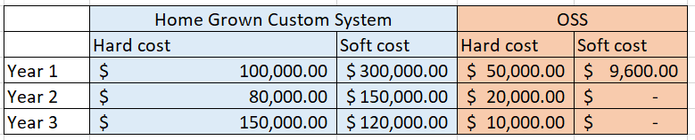
OSS - Return On Investment
Kafka vs Custom System
Kafka Hard costs: Consultation charges
Kafka Soft costs: Human resource charges for installation and configuration: (2 resources * $40/hr)^{[44]}
Custom System Hard costs: Clusters and software resources cost, scalability costs^{[44]}
Custom System Soft costs: Salaries - (5 developers, 2 testers, 2 maintenance, 1 project manager)
It’s expensive to write custom system from scratch.
Replacing custom development with use of open source software offers significantly lower costs and raises the ROI of the open source option well above custom software development
References: https://fossbazaar.org/system/files/Open.Source.ROI_.Whitepaper.pdf
Notes:
Reference: https://fossbazaar.org/system/files/Open.Source.ROI_.Whitepaper.pdf[44]
s a successful project will yield

Slide 44
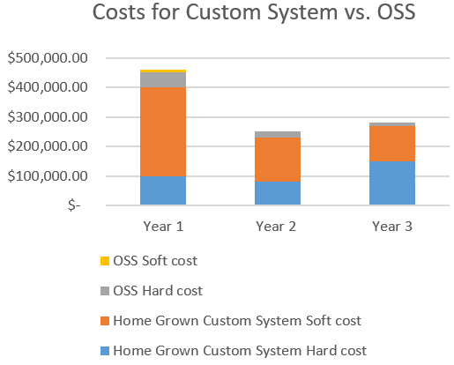
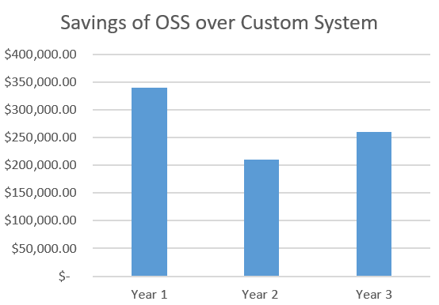
OSS - Return On Investment

Slide 45
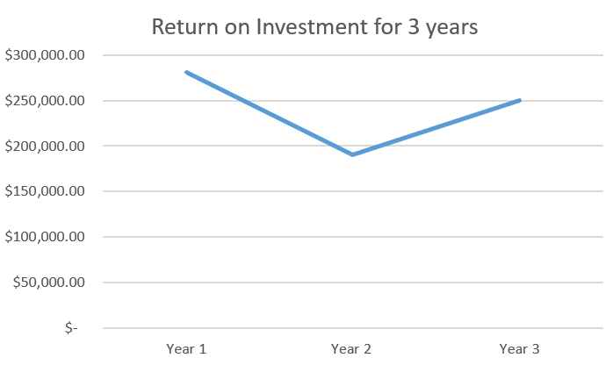
OSS - Return On Investment
ROI would be significantly high in Year 1 as OSS saves a lot as compared to custom system in terms of costs.
In Year 2, the savings are less than that of Year 1
However, in Year 3, the custom system will face scalability issues which will again increase hard costs for servers and soft cost for maintenance resources . Hence, the ROI for OSS will again start rising in Year 3
Formula used: ROI = [(Gain – Project cost) / Project cost] x 100^{[45]}
References: https://www.isixsigma.com/operations/finance/calculating-roi-realize-project-value/
Notes:
Reference: https://www.isixsigma.com/operations/finance/calculating-roi-realize-project-value/[45]

Slide 46
Project - Return On Investment^{[45]}
Project Cost: 24 Members * 2080 hrs * $70 (on average) = $3,494,400 a year
Financial Value:
Year 1 (2018-2019): No return
Year 2 (2019-2020):
Human Resource reduction: 12 * 2080 * $ 50 (on average) = $1,248,000
Utilizing cancelled 3456 trucks, 1789 trailers and 1211 towing vehicles: 91,653 + 55,645 + 38,910 = $186,208
Year 3 (2020-2021)
Human Resource reduction: 24 * 2080 * $ 50 (on average) = $2,496,000
Utilizing cancelled 3456 trucks, 1789 trailers and 1211 towing vehicles: $186,208
Reference: https://www.isixsigma.com/operations/finance/calculating-roi-realize-project-value/
Notes:
Reference: https://www.isixsigma.com/operations/finance/calculating-roi-realize-project-value/[45]
The formula for determining ROI is: ROI = [(Financial value – Project cost) / Project cost] x 100
TVD^{Present} – TVD^{Project}
Where:
• T = Time required for the process
• V = Volume or quantity of units, transactions, people, etc. required
• D = Dollars or cost required
• Present = Current value
• Project = Values a successful project will yield
Financial Value
Financial value is simply the project’s payback. Calculating value can sometimes be complicated based on the uncertainty of assigning actual dollars to a proposed outcome. The trick is breaking down the value into presently known components and then defining those components.
Showing your solution is going to improve ROI because it improves accountability, that may not be true in short term! Even if it does bring in money, it may not return much considering the costs involved. If you present to management that in long run, the initiative would bring ROI and so the costs are justified, you may not get an immediate support. You may explain that this platform would encourage continuous improvement and provide a platform for further efficiency improvement. Would management hear to that? Perhaps no.

Slide 47
Project - Return On Investment^{[45]}
Year | Cost | Savings | ROI
Year 2018-2019 | $3,494,400 | 0 | ($3,494,400)
Year 2019-2020 | 0 | $1,434,208 | ($2,060,192)
Year 2020-2021 | 0 | $2,682,208 | $622,016
Reference: https://www.isixsigma.com/operations/finance/calculating-roi-realize-project-value/
Notes:
Reference: https://www.isixsigma.com/operations/finance/calculating-roi-realize-project-value/[45]
The formula for determining ROI is: ROI = [(Financial value – Project cost) / Project cost] x 100
TVD^{Present} – TVD^{Project}
Where:
• T = Time required for the process
• V = Volume or quantity of units, transactions, people, etc. required
• D = Dollars or cost required
• Present = Current value
• Project = Values a successful project will yield
Financial Value
Financial value is simply the project’s payback. Calculating value can sometimes be complicated based on the uncertainty of assigning actual dollars to a proposed outcome. The trick is breaking down the value into presently known components and then defining those components.
Showing your solution is going to improve ROI because it improves accountability, that may not be true in short term! Even if it does bring in money, it may not return much considering the costs involved. If you present to management that in long run, the initiative would bring ROI and so the costs are justified, you may not get an immediate support. You may explain that this platform would encourage continuous improvement and provide a platform for further efficiency improvement. Would management hear to that? Perhaps no.

Slide 48
Project - Return On Investment
The ROI has been calculated based on different Performance Metrics:
Saving on Human Resources^{[45]}
Currently the company has 8 teams each having 6 members on an average working on replication and maintenance of data pipelines. After Implementing Kafka we will not be needing 75% of these resources as we are moving towards an easy scalable platform. Also we will be reusing existing hardware resources for this project.
Optimum utilization of resources (Rental Trucks)^{[45]}
Currently our system is unable to track the cancelled requests in real-time, due to which approximately 3456 trucks, 1789 trailers and 1211 towing vehicles are left un-utilized on a yearly basis. We would be re-renting these vehicle once we get cancellation request and the inventory gets updated in the real-time.
Note: These values are based on the companies historical data.
Reference: https://www.isixsigma.com/operations/finance/calculating-roi-realize-project-value/
Notes:
Reference: https://www.isixsigma.com/operations/finance/calculating-roi-realize-project-value/[45]
The formula for determining ROI is: ROI = [(Financial value – Project cost) / Project cost] x 100
TVD^{Present} – TVD^{Project}
Where:
• T = Time required for the process
• V = Volume or quantity of units, transactions, people, etc. required
• D = Dollars or cost required
• Present = Current value
• Project = Values a successful project will yield
Financial Value
Financial value is simply the project’s payback. Calculating value can sometimes be complicated based on the uncertainty of assigning actual dollars to a proposed outcome. The trick is breaking down the value into presently known components and then defining those components.
Showing your solution is going to improve ROI because it improves accountability, that may not be true in short term! Even if it does bring in money, it may not return much considering the costs involved. If you present to management that in long run, the initiative would bring ROI and so the costs are justified, you may not get an immediate support. You may explain that this platform would encourage continuous improvement and provide a platform for further efficiency improvement. Would management hear to that? Perhaps no.

Slide 49
Historical Data used for ROI

Slide 50
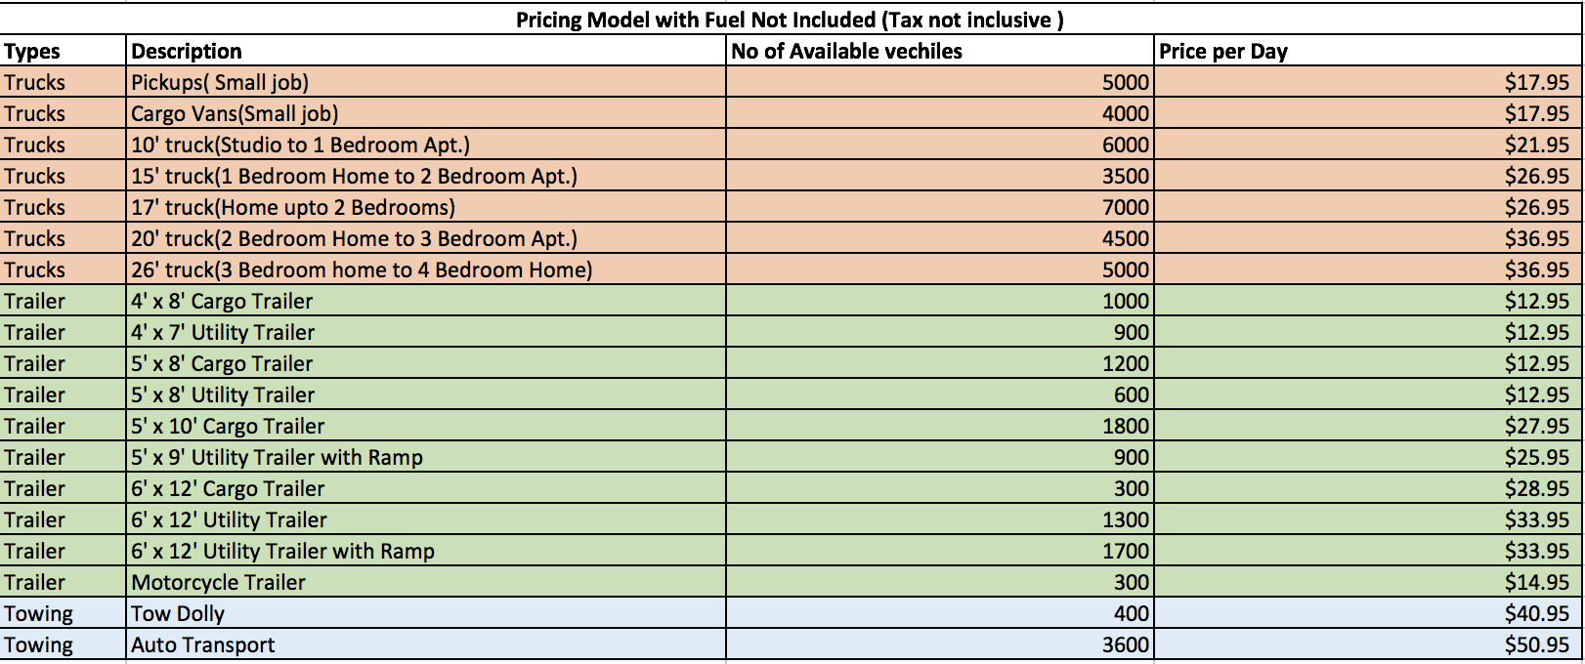
Company - Pricing of vehicles

Slide 51
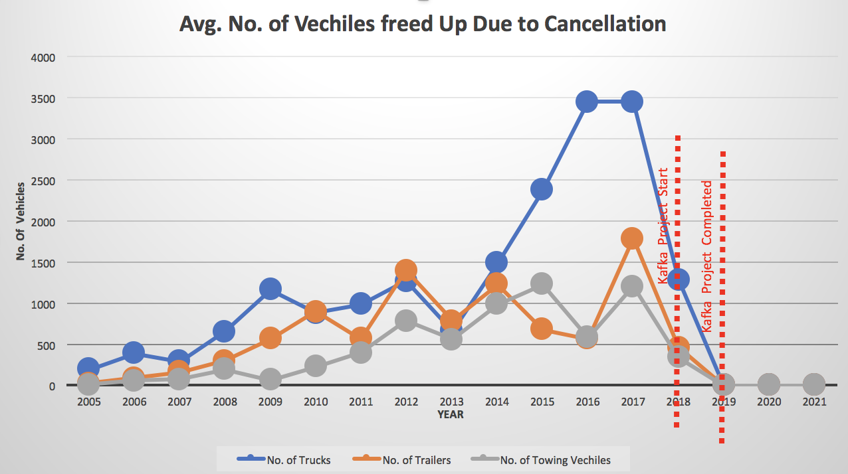
Vehicles Analytics
The Visual is based on Company historical data and Projections for future after the kafka Project has been completed
This visual represents the avg. no of vehicles left unused due to cancellation per year
From 2019 we project that the system would be up & running and the vehicles will be allocated will show as free upon cancellation in real time

Slide 52
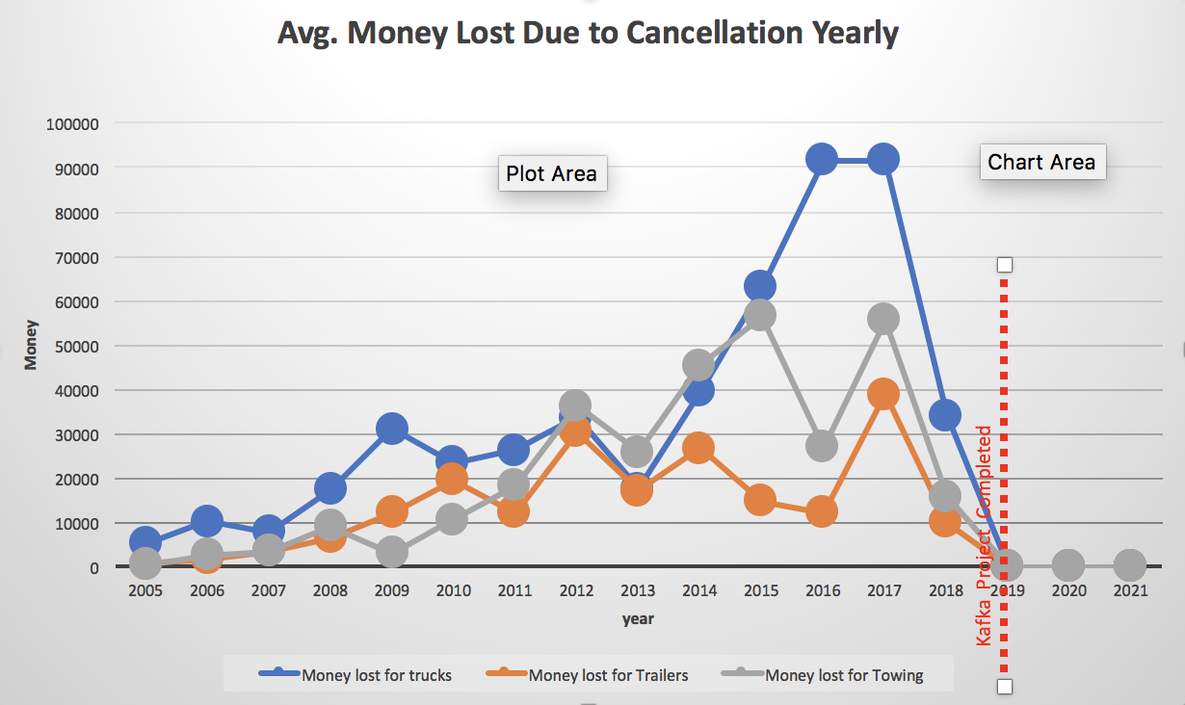
Vehicles Analytics
The Visual is based on Company historical data and Projections for future after the kafka Project has been completed
This visual represents the avg. Money lost due to no of vehicles left unused due to cancellation per year
From 2019 we project that this value will go to zero

Slide 53
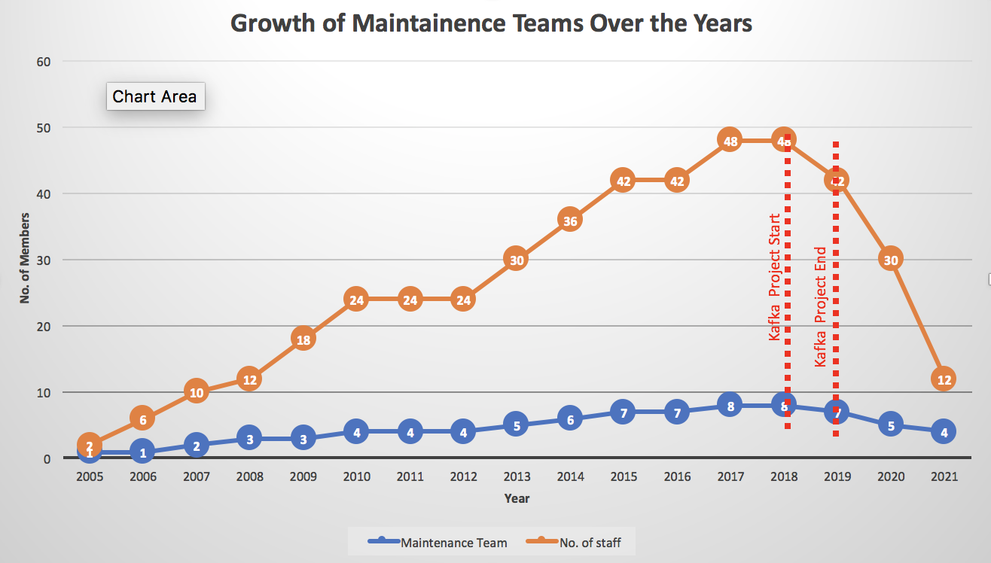
Maintenance Team Growth Over the Years
The Visual is based on Company historical data and Projections for future
This visual represents how the maintenance team has grown over the years to manage the backend in house infrastructure
In 2018 we have 8 teams of 6 members each
From 2019 we project that this there would be 75% drop in the maintenance teams
The planned reduction starts in phases with 6 members in the 1st year, 12 in 2nd & 18 in 3rd
In year 2021 there will be 4 teams of 3 members each

Slide 54
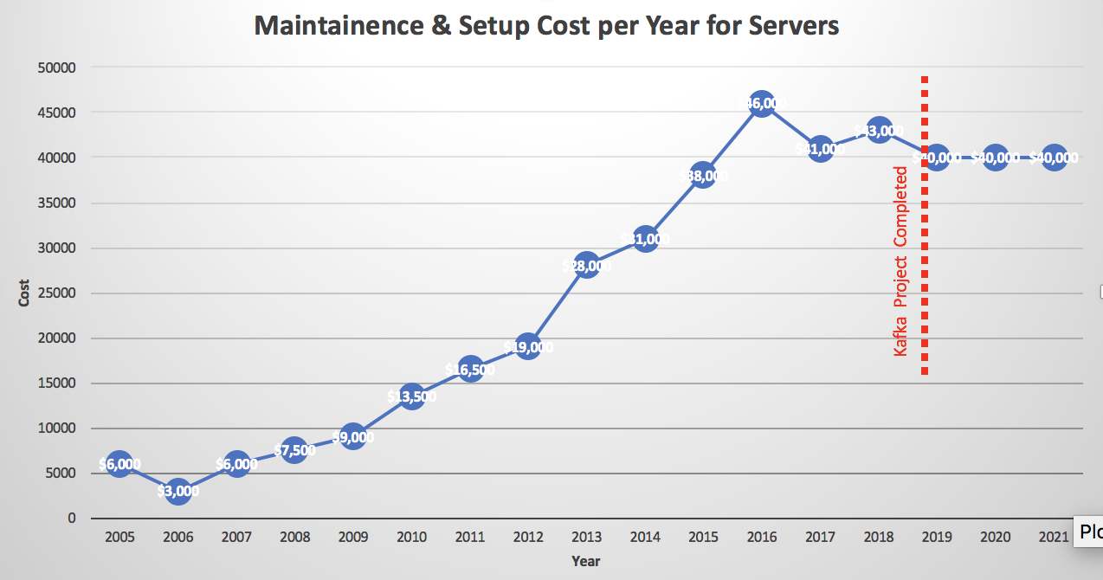
Maintenance and Server Setup Cost
The Visual is based on Company historical data and Projections for future
This visual represents the maintenance & setup cost of servers to manage the backend
In 2018 we have 20 servers including addition of 1 new server costing a total of $43000
Maintaining 1 server cost’s around $2000 in 2018 & adding a new server cost around $5000
We estimate that kafka can cause 10% reduction of server usage per year and we would not need to add any new servers for next 3 years
Hence, for the next 3 years the ctc for 20 servers @ $2000 each will be $40000

Slide 55
SECTION - IV
S.No. | Topic | Slide No.
1 | Project - Return On Value | 56-57
2 | Design Approach: Top Down - Depth First | 58
3 | Benefits of Design approach | 59
4 | SDLC Model - Extreme Programming | 60
5 | Why Extreme Programming? | 61
6 | Extreme Programming Process | 62-63
7 | Extreme Programming Metrics | 64

Slide 56
Project- Return On Value
External
Use of Kafka is to add the data streaming capability in the existing system.
Internal users will be using the existing system with enhanced data handling capabilities
Real-time data will bring significant improvement in analytics segment and
which in turn can contribute in better decision making
Internal
Real time data would be beneficial
Pricing Analytics and efficient Inventory management
Earlier we had end of day batch processing and analyst had to wait till next day morning to start with analysis.
With Real- time streaming of data, internal users() get to do use data intraday

Slide 57
Project - Return On Value
Price optimization analytics would accelerate sales by providing best prices to customers.
Proper analysis of the manner in which consumers spend to make the most revenue in each situation
Analytics to estimate customer response and essential drivers of demand
Price history and trends for products
Accurately manage inventory to forecast out stock products
Minimal back orders
Advertising campaigns and promotions to target specific customers

Slide 58
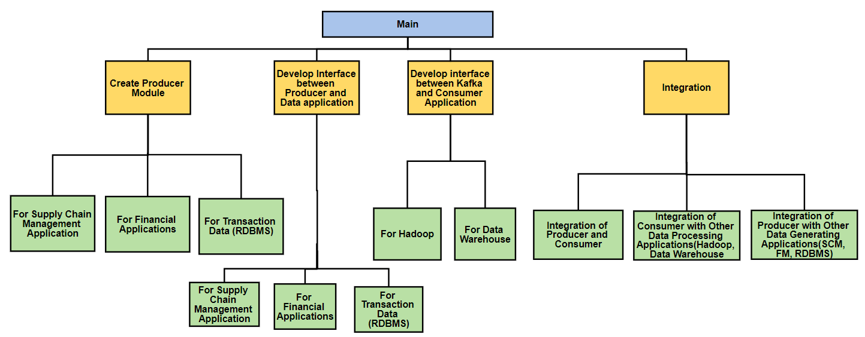
Project Design Approach: Top Down - Depth First

Slide 59
Benefits of Design approach
No need of writing our own modules to accept the data from Producers^{[46]}
No need of writing our own modules to process and feed the data to Consumers.
Kafka has inbuilt Broker modules which take care of all these things.
Saves human and hardware resources
References: https://docs.confluent.io/current/clients/producer.html
Notes:
References: https://docs.confluent.io/current/clients/producer.html[46]

Slide 60
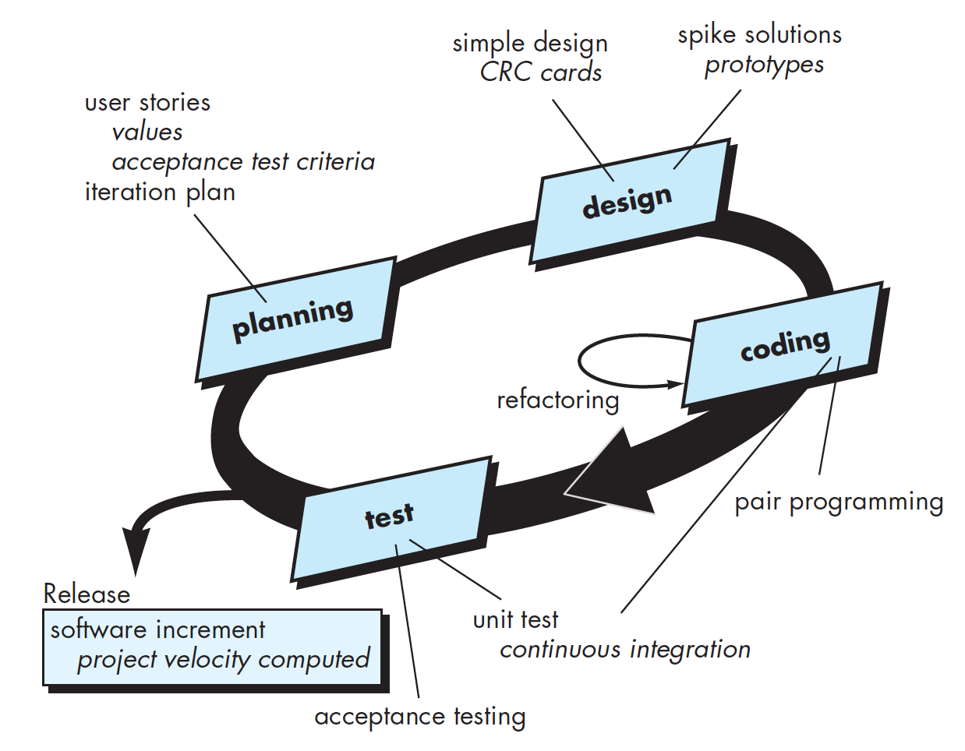
SDLC Model - Extreme Programming
Most widely used approach to agile software development
Best Practices
Early Release Planning
Frequent Statusing
Coding Standards
Simple Design
Planned frequent integrations
Test before Code
Pair Programming
Reference: Software Engineering, A Practitioner’s Approach, Eighth Edition. Roger S. Pressman, Bruce R. Maxim. McGraw-Hill. ISBN 0-07-802212-6. 5.4 EXTREME PROGRAMMING [9]
Notes:
Reference: Software Engineering, A Practitioner’s Approach, Eighth Edition. Roger S. Pressman, Bruce R. Maxim. McGraw-Hill. ISBN 0-07-802212-6. 5.4 EXTREME PROGRAMMING Page 72 [9]
Reference: MSIS2606 23-25-30Jan.pdf

Slide 61
Why Extreme Programming?
Test before coding
Our Business has been established
We are adopting OSS to streamline existing business
We know the test cases in advance
Heavy internal customer interaction - Data Analyst, Business Analyst, Data Engineers
Expectation from the software is clear and they want to play a role in shaping its development
Pair programming
Buddy will help in knowledge sharing ^{[9]}
Avoid tunnel vision in coding
Efficient collaboration - Skills will be combined
Focus on bigger picture with continuous code review
Reference: Software Engineering, A Practitioner’s Approach, Eighth Edition. Roger S. Pressman, Bruce R. Maxim McGraw-Hill. ISBN 0-07-802212-6. 5.4 EXTREME PROGRAMMING [9]
Notes:
Pic Reference: Software Engineering, A Practitioner’s Approach, Eighth Edition. Roger S. Pressman, Bruce R. Maxim. McGraw-Hill. ISBN 0-07-802212-6. 5.4 EXTREME PROGRAMMING [9]
Page 73
Add para...Nikhil

Slide 62
Extreme Programming Process
Planning
This will begin with listening
Customers like Data Engineer, Data Analyst, Business Analyst will let the team know about their user stories and it will be placed on index card
They will assign a priority value to each of the user stories
They will decide on which stories will go into the next release
Design
We will be following the keep it simple design process
This will be an implementation guidance for user stories using CRC cards ^{[11]}
Create prototype for difficult design issues
Design will be continued into the coding process also
Reference: https://en.wikipedia.org/wiki/Extreme_programming_practices#Planning_game[11] Pic Reference: Software Engineering, A Practitioner’s Approach, Eighth Edition. Roger S. Pressman, Bruce R. Maxim. McGraw-Hill. ISBN 0-07-802212-6. 5.4 EXTREME PROGRAMMING[9]
Notes:
Reference: https://en.wikipedia.org/wiki/Extreme_programming_practices#Planning_game[11]
Pic Reference: Software Engineering, A Practitioner’s Approach, Eighth Edition. Roger S. Pressman, Bruce R. Maxim. McGraw-Hill. ISBN 0-07-802212-6. 5.4 EXTREME PROGRAMMING[9]
Page 73,74

Slide 63
Extreme Programming Process
Coding
Once the stories and design are in place, teams work on test cases
Because the exact usage of system is known, the test cases will ensure maximum unit test coverage
Because of pair programming, code will be reviewed as its created ensuring quality assurance
One will work on coding and other will focus on Coding Standards
Continuous integration with code developed by other programmers catching integration issues early on^{[9]}
Test
Automating the unit testing in order to repeat testing
Integration and Validation testing
As per acceptance criteria in user stories, Acceptance tests will be specified by customers
Reference: Software Engineering, A Practitioner’s Approach, Eighth Edition. Roger S. Pressman, Bruce R. Maxim. McGraw-Hill. ISBN 0-07-802212-6. 5.4 EXTREME PROGRAMMING - Page 74,75[9]
Notes:
Reference: Software Engineering, A Practitioner’s Approach, Eighth Edition. Roger S. Pressman, Bruce R. Maxim. McGraw-Hill. ISBN 0-07-802212-6. 5.4 EXTREME PROGRAMMING[9]
Page 74,75

Slide 64
Extreme Programming Metrics
OSS benefit to Project
Failing Tests: The acceptable percentage of failing tests less than or equal to 2% [34]
Acceptable overtime percentage should not be more than 12%
Test First Design: Not less than 98%
Load factor: about 2.5 ^{[35]}
The Apache kafka Foundation development process publishes list of features 4 weeks ahead which will help in planning and scheduling of for upgrade of kafka in the project.
They have an IRC channel which can be used for interactive discussion in order to solve issues or discuss implementation details. ^{[36]}
References:
[34] https://www.agilealliance.org/glossary/xp/ 35] http://csis.pace.edu/~marchese/CS616/Agile/XP/XP_Overview.pdf [36] https://kafka.apache.org/contact ge 74,75[9]
Notes:
[34] https://www.agilealliance.org/glossary/xp/
[35] http://csis.pace.edu/~marchese/CS616/Agile/XP/XP_Overview.pdf
[36] https://kafka.apache.org/contact ge 74,75[9]

Slide 65
SECTION - V
S.No. | Topic | Slide No.
1 | User Requirements | 66
2 | User Persona | 67-69
3 | User Story | 70-72
4 | Business Requirement Document V1.0 | 73-80
5 | Testing - Scope | 81
6 | Test Approach | 82
7 | Testing Resources | 83
8 | Test Schedule | 84
9 | Risk Assessment & Risk Table | 85

Slide 66
User Requirements
System should be able to do real time stream processing
System should be able to balance the processing load as and when new instances are added ^{[23]}
System should order the data records
System should be able to do stateful computations like aggregation and joins ^{[24]}
Reference: https://www.confluent.io/blog/introducing-kafka-streams-stream-processing-made-simple/ [23] http://www.ofnisystems.com/services/validation/user-requirement-specifications/ [24]
Notes:
https://www.confluent.io/blog/introducing-kafka-streams-stream-processing-made-simple/[23]
The User Requirements Specification describes the business needs for what users require from the system. User Requirements Specifications are written early in the validation process, typically before the system is created. They are written by the system owner and end-users, with input from Quality Assurance. Requirements outlined in the URS are usually tested in the Performance Qualification or User Acceptance Testing. User Requirements Specifications are not intended to be a technical document; readers with only a general knowledge of the system should be able to understand the requirements outlined in the URS.
Reference: http://www.ofnisystems.com/services/validation/user-requirement-specifications/ [24]

Slide 67
User Persona
Data Engineer - A data engineer at OSS Packers and Movers extract, transform and load data for analytical and operational use. They create data pipelines by pulling together data from different sources. They are responsible for providing simplified and clean data to the business users and data analyst with simplified access to prepared data set.
Data Analyst - A data analyst at OSS Packers and Movers translate the numbers and interpret them to understand the business performance in terms of revenue, sales, customer base and cost. They use the prepared data set that the data engineer provides, analyze the important metrics and document them.

Slide 68
User Persona
Product Manager - A Product manager is responsible for setting the strategy, roadmap, and feature definition for re-architecturing the existing system with Kafka. The manager provides inputs on what has to be implemented in the kafka system and why it has to be implemented after accessing the internal and market demand. He guides the data engineers on building process of Kafka.
Business Analyst - Business Analyst is responsible for gathering the requirements, translating the overall requirements into functional and non-functional requirements, process change requests, conduct cost/benefit analysis and provide these documentation to the product management team for review and then hand them to system analyst.

Slide 69
User Personas
System Analyst - System Analyst at OSS Movers & Packers analyze the design techniques for implementing kafka system and works closely with business analyst. System analyst will conduct code review, modify them and even write technical requirement for a critical phase. They provide the use cases, flow charts and UML to the designers and developers.

Slide 70
User Story
As a Data Engineer, I want to be able to create a highly scalable data management system so that it can capture up to 10 millions events at a time.
Acceptance Testing - Kafka should be able to scale to achieve 10 million events processed
As a Data Engineer, I want to be able to implement real-time data flow so that I do not have to manually code or script for ad hoc data pull requests.
Acceptance Testing - Kafka topic must be updated within 30 millisecond whenever a new event occurs in any database

Slide 71
User Story
As a Product Manager I want to assess market data in order to better understand how consumers use our product so that I can create requirements that better match user needs
Acceptance Test: Product Manager should be able to access data from all the data sources seamlessly in order to increase the scope of the product.
As a Data Analyst, I want to be able to visualize number of visitors to the web-site to the revenue generated so that I can analyze the performance of the web-page.
Acceptance Testing - The database should store data for site visitors and sales co-related.

Slide 72
User Story
As a System Analyst, I want to be able to create a real-time data streaming system with latency lesser than 30 milliseconds.
Acceptance Testing - The system should be able to process data within 30 milliseconds.
As a Business Analyst, I want the data being generated to be uniform and standardized so that it can be analysed in real-time to provide actionable insights to the target teams. The data should be available for all the departments ranging from our company to user behaviour so that effective business decisions can be made.
Acceptance Test: Analyst should easily be able to clean and validate the data after which it can be properly stored in DataStores/Data Warehouse.

Slide 73
Business Requirement Document v1.0
1.1 Objectives
Offer an ideal relocation and packaging service application that can handle 10 million customer requests in real-time
Build an application that is capable of handling various types of data like customer requests, order shipments, inventory data, sales, products etc. without any latencies
Fill the gap in data infrastructure by choosing Kafka as the main engine underneath and write our own library to facilitate application developers
Increase the flexibility to adapt to new business requirements as the company is growing as well as the number of requests per customer.
Business Optimization by switching to a real-time based approach.

Slide 74
Business Requirement Document v1.0
1.2 Background
Initially we went with a low-level data model for our business, where our use cases were simple and clearly defined over the time as the business grew, complexity of the system increased.
· Centralized database - databases are increasing as the business is growing
· Limitation on scaling in current Hadoop ecosystem and traditional ETL
· Not able to handle real-time data
· Big batch processing
· Processes like price and inventory adjustments need real time data processing.
We need a sophisticated data pipeline which can scale quickly, and which would be highly efficient to move data around whole data pipeline.
·

Slide 75
Business Requirement Document v1.0
1.3 Business Drivers
Need of a real-time streaming platform for processing data like sales, price, inventory, customer experiences, shipments, system crash, etc.
Dynamic pricing will provide the capability to match with competitors’ prices
Accurately manage inventory to forecast out stock products

Slide 76
Business Requirement Document v1.0
2 Project Scope
2.1 In Scope Functionality
Create a Kafka producer module which can accept the data from below applications
Supply Chain Management Application (Oracle SCM)
Financial Application (Oracle FCM)
Transaction Data coming from online platform
Ability to handle 10 million records at a time
Create an interface between Kafka and the applications mentioned above
Create an interface between Kafka and Consumer Applications mentioned below:
Data Warehouse & Hadoop
Provide audit trail of all the data operations
Integrate all the above modules using Kafka connect form a sophisticated data pipeline.

Slide 77
Business Requirement Document v1.0
2 Project Scope
2.2 Out of Scope Functionality
This project leverages Kafka only for implementing stream processing and not for log aggregation and messaging
Integrating Kafka with Elasticsearch is not in the scope of this project

Slide 78
Business Requirement Document v1.0
3 Business Requirements
3.1 Functional Requirements
The producer module should be able to accept data from Supply Chain Management application (Oracle SCM), Financial Applications (Oracle FCM) and transactional data store(RDBMS).
The system should be able to handle streams of events or data changes and feeds these to other consumer data systems such as Data Warehouse and Hadoop.
The system will be able to handle both structured and unstructured data

Slide 79
Business Requirement Document v1.0
3 Business Requirements
3.2 Functional Requirements
4. Kafka will act as an intermediary between the producer and the consumer. It will use the API's to get and broadcast data to consumer applications.
5. Schema Registry to centrally manage schemas, validate compatibility, and provide warnings if data does not conform to the schema

Slide 80
Business Requirement Document v1.0
3.2 Non-Functional Requirements
Producer
Parameters:
200 byte messages
200 message batches
40k batch size
Results:
90 MB/sec throughput
Broker
Parameters:
100 topics
100k broker flush interval
Consumer
Parameters:
1MB consumer batch size
Results:
60 MB/sec throughput
220 ms latency from producer

Slide 81
Testing - Scope
SCOPE
Test scenarios/Test objectives that will be validated such as integration testing with the database and reporting platform, unit testing on every kafka module for successful stream delivery, API testing
Define the target or the goal of the test based on above features clearly
Enhanced clarity on what we are not going to cover such as install/uninstall testing
All the conditions that need to hold true for us to be able proceed to next phase like max allowable 5% error rate in data replication
Testing Reports after every test giving information on the use case used to test, expected and actual output

Slide 82
Test Approach
White box testing: Testing on each level of development
Unit Testing: Test Kafka producer, Kafka consumer and Kafka integration module
Integration Testing: Testing the module in which we integrate all the individual modules (consumer, producer and integration)
System Testing: Conducted to understand if the system is able to accomodate 10 million request and retrieve data in 300 milliseconds without system failure
Blackbox testing: Testing if features promised i.e. rate and ratings are available on a dynamic time basis on clicking and keystrokes on our website
Alpha Testing: Release first version of system after implementing transactional data pipeline and test it internally with the financial analyst team. Similarly for other departments and sources.
Security Testing: System handles sensitive data and hence security testing is a very important step. It will be performed before and after integration.

Slide 83
TESTING RESOURCES
Human Resource
Test Manager: does project management, lays rules for testing
Tester: executes tests, logs the results, reports defects
Internal customers:
Quality Assurance tester: makes sure that the testing process meets requirements
Test Designers: Implements test cases, test program, test suite.
Software
JIRA
IBM Rational Test Workbench
Bugzilla
Kafka Monitor Tool
Hardware
PC’s
Web Server
Testing tool
LAN
DB Server

Slide 84
TEST SCHEDULE
TASK | TASK ASSIGNEE | ESTIMATED EFFORT (in man-hours)
Test Plan Document delivery | Test Designer | 60
Test Design Document delivery | Test Designer | 130
Create Test Specification | Test Manager | 95
Perform Test Execution | Tester | 140
Test Report | Tester | 75
Defect Report | Tester | 45
Test Cases delivery | Test Designer | 90
Release notes delivery | Test Manager | 45

Slide 85
Risk Assessment
For this Project Proposal the Risks can be categorized Into the following major categories:
Technical Risks
Integration issues - Compatibility with data sources ^{[25]}
Business Risks
Business impact in terms of monetary investment due to re - architecturing the back end ^{[25]}
Process Risks
Proposed changes will be implemented in phases where some risk scenario may arise ^{[25]}
Staffing Risks
This proposal will need both valuable and expert resource at the right time and with the right training. ^{[25]}
Product Risks
Initially there can be some data loss issues. ^{[25]}
Reference : https://opentextbc.ca/projectmanagement/chapter/chapter-16-risk-management-planning-project-management/[25]
Notes:
https://opentextbc.ca/projectmanagement/chapter/chapter-16-risk-management-planning-project-management/[25]
Process Risks
Proposed changes will be implemented in phases where some risk scenario may arise
Design refactoring can increase effort and become a risk to the project by delaying schedule

Slide 86
SECTION - VI
S.No. | Topic | Slide No.
1 | Risk Table | 87
2 | Mitigation Plan | 88-89
3 | Deprecation Management Policy | 90-91
4 | Roadmap | 92-93
5 | Release Plan | 94-95
6 | Project Plan | 96-98
7 | Conclusion | 101
8 | Group Learning Goal | 102
9 | References | 103-106

Slide 87
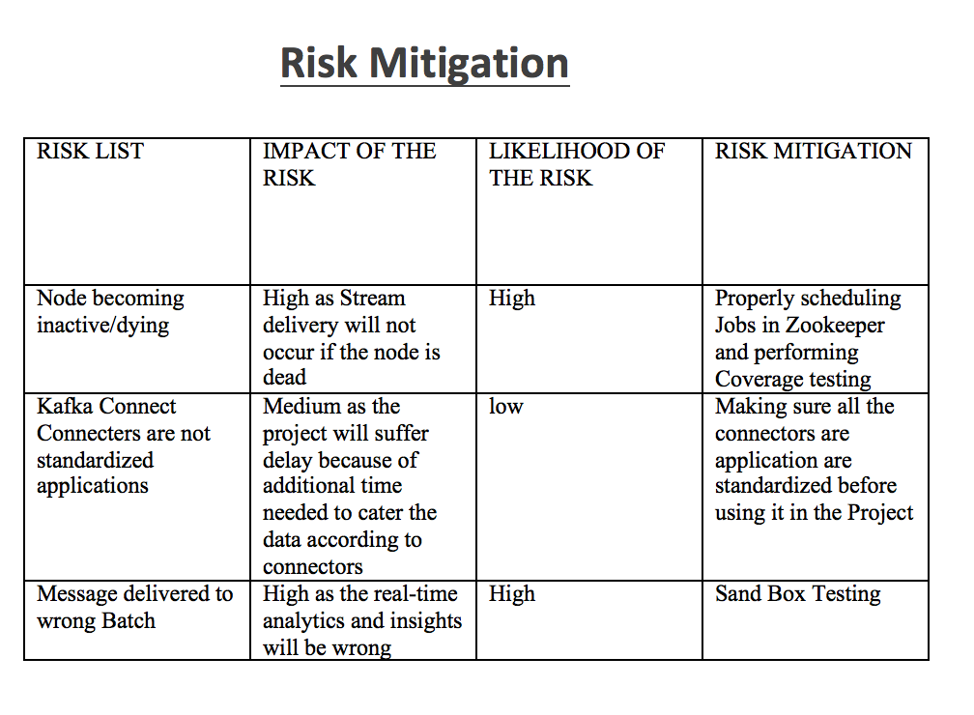
Risk Table
Reference: https://gist.github.com/markrendle/26e423b6597685757732[26]
https://community.mapr.com/thread/21763-kafka-connect-vs-streamsets-advantages-and-disadvantages[27]
Notes:
https://community.mapr.com/thread/21763-kafka-connect-vs-streamsets-advantages-and-disadvantages[27]
There is a possibility of data loss. This is because of the architecture of Kafka. A ‘Node’ can die and this leads to new ‘Leadership election’. There will be a 6 seconds delay for the system to update new metadata. If the message is sent during these 6 seconds to the system, we might lose the data.
Kafka Connect connectors for different applications or data systems are not maintained within Apache Kafka main code base. Although many are available as open source, certified, maintained and supported by a few vendors, many other connectors might be lacking features or might not be kept up-to-date or ready for prime time.
https://gist.github.com/markrendle/26e423b6597685757732[26]
https://community.mapr.com/thread/21763-kafka-connect-vs-streamsets-advantages-and-disadvantages[27]

Slide 88
Mitigation Plan
Finally there are majorly 4 ways to handle any risks. They are:
Risk avoidance
So the alternate strategy for this case is to use the traditional method to generate data for analysis ^{[28]}
Risk sharing
It involves partnering up with other companies in joint ventures to share the risk costs but this also means that there has to be some knowledge transfer; leading to high competition, losing the cutting edge technology and ultimately less profit ^{[29]}
Reference: https://www.pmi.org/learning/library/mitigating-risk-project-negotiations-preplanning-469 [28]
https://bizfluent.com/about-6311682-mitigation-plan-project-managing-.html [29]
Notes:
References: https://www.pmi.org/learning/library/mitigating-risk-project-negotiations-preplanning-469 [28]
https://bizfluent.com/about-6311682-mitigation-plan-project-managing-.html[29]

Slide 89
Mitigation Plan
Risk reduction
To reduce risks our company is hiring top committers and subject matter experts as Project Manager ^{[30]}
Risk transfer
There are no risk transfer as we don’t plan to hire third party to develop our product as this is potentially cutting edge tech. in our industry ^{[30]}
Reference: https://www.pmi.org/learning/library/mitigating-risk-project-negotiations-preplanning-469 [30]
Notes:
Reference: https://www.pmi.org/learning/library/mitigating-risk-project-negotiations-preplanning-469 [30]

Slide 90
Deprecation Management Policy
Deprecation Policy:
The final product will have more security features than the prototype version.
Older implementations and functionality replaced by latest versions.
Deprecation Process:
All the deprecation policies will be communicated to the client. A team will be created to handle this.
JIRA tool will be used to manage deprecations.

Slide 91
Deprecation Management Policy
Product version | Deprecation | Sunset
v1.2 | April 2025 | June 2025
v1.1 | July 2022 | September 2022
v1.0 | October 2020 | December 2020

Slide 92
ROADMAP

Slide 93
GOAL
“To develop a system that can handle real time data streaming and thereby assist users with quality services and cheapest available prices”
July 2018
December 2018
May 2019
Streamlining Supply Chain Management
Streamlining Transactional Data
Streamlining Finance Data
Forecasting of demand on point of sale
Developing just in time capabilities in system
Real time analytics to improve ROI & ROV
Increase in operating margins over past year
Real Time updates to financial metrics

Slide 94
RELEASE PLAN

Slide 95
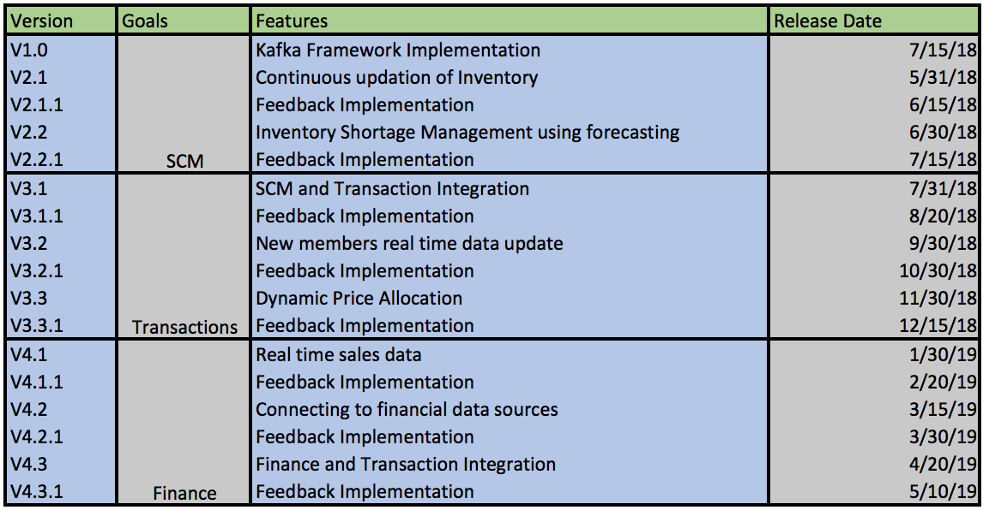

Slide 96
Project Plan
There are 24 employees working on implementation of Kafka.
While planning and scheduling the project, we have considered the Holidays, weekends and Pad Task.
The project starts on April 1st week of 2018 and finish on May Last week of 2019.
Because we are following XP, we have accounted for test case written before development
We have accounted for User Acceptance Testing after each iteration
We have 8 releases and releases and are feature driven.

Slide 97
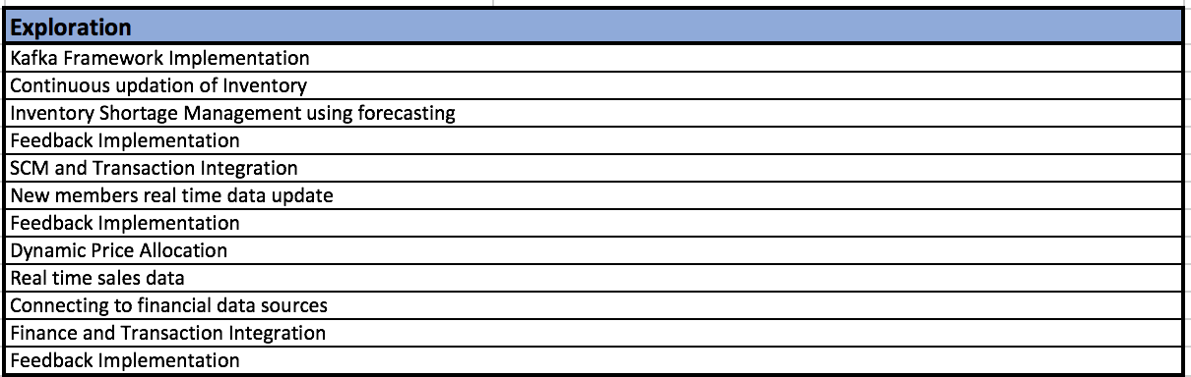
Exploration

Slide 98
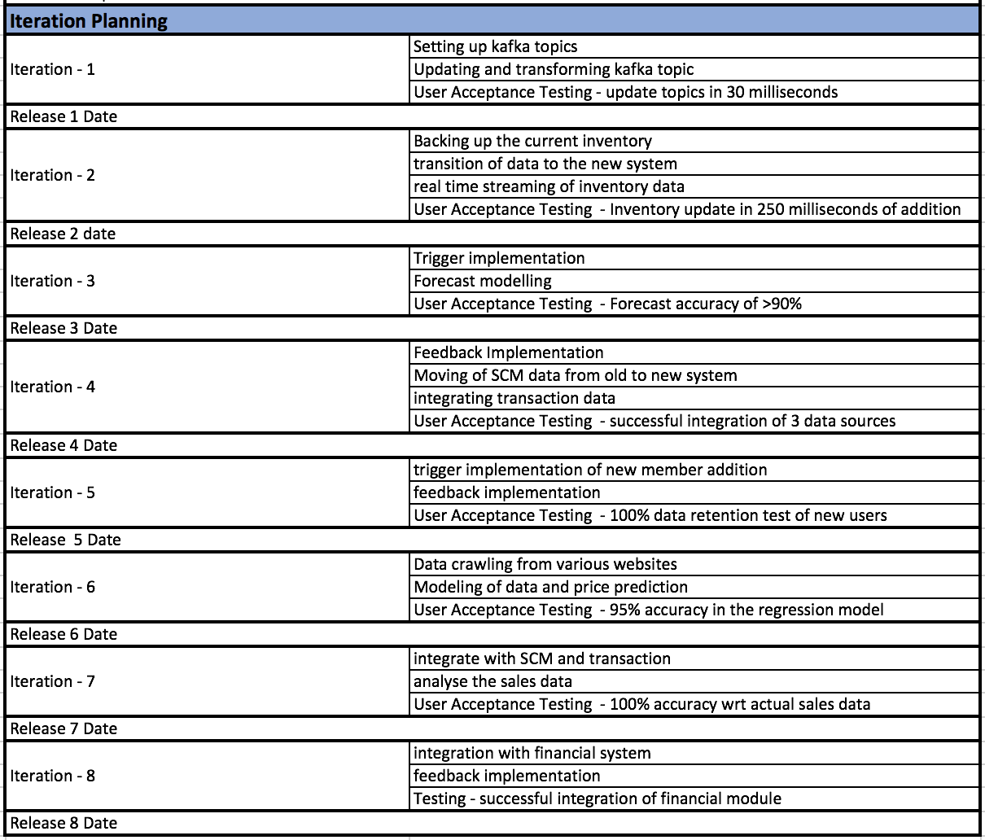
Iteration Planning & Iterations

Slide 99
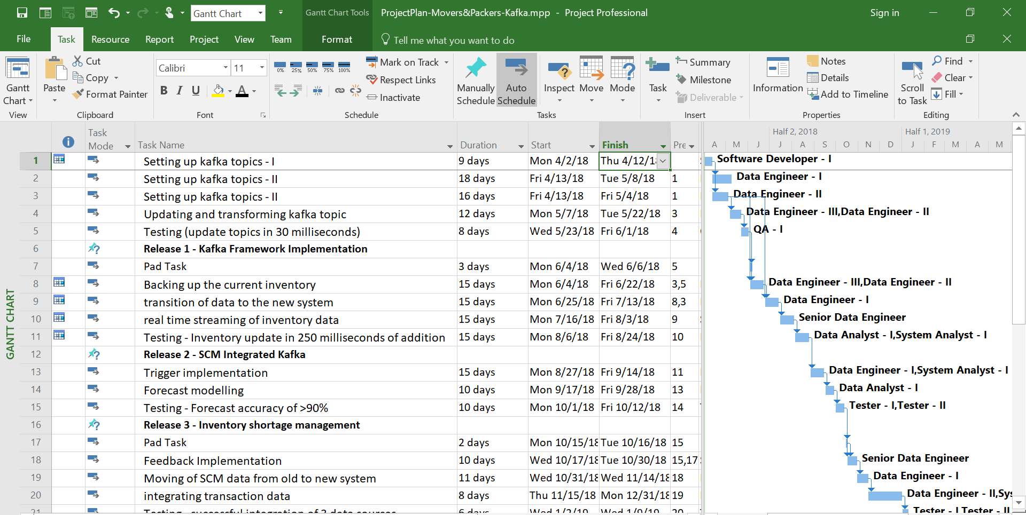

Slide 100
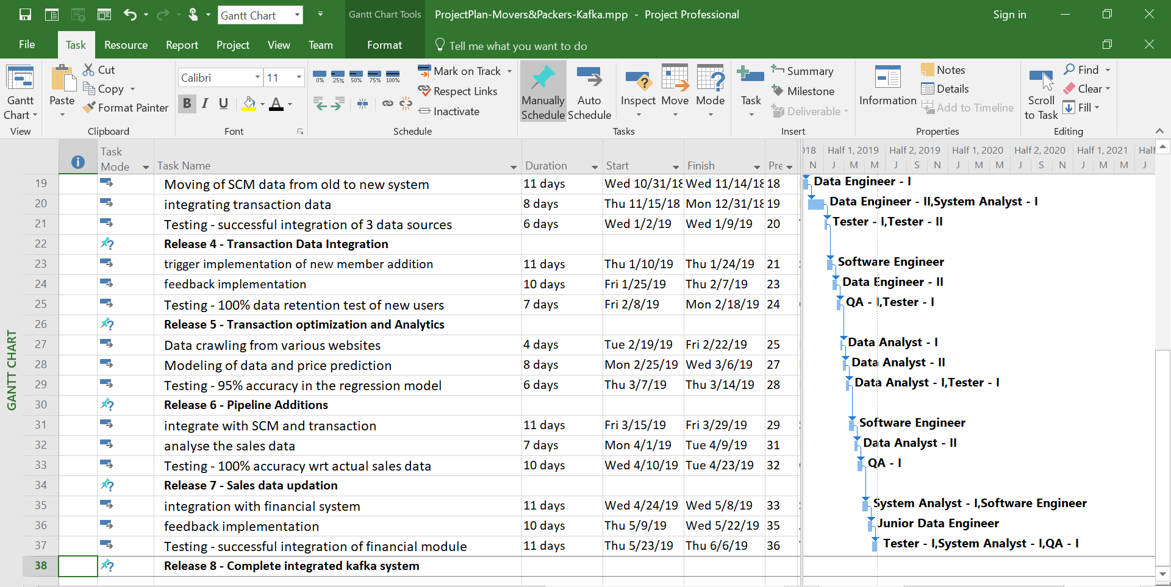

Slide 101
Conclusion
Kafka enhances our business scenario by adding scalability
Real time updation to customer orders and inventory will make the process seamless
Kafka will provide us the capability to process data in real time for prescriptive and descriptive analytics
Successful implementation of this project will result in a clean new architecture where each entity is isolated and independent
Backtracking will be easy once the new back end system is up and running
Ease in scalability

Slide 102
Group Learning Goals
Learn in depth about the end to end process of undertaking a new project in a company
Project scoping along with feasibility analysis
Simulate a real team in order to learn about working in collaborative manner
Develop resource management and project management skills

Slide 103
References
[1] https://kafka.apache.org/
[2] https://www.confluent.io/blog/the-future-of-etl-isnt-what-it-used-to-be/
[3]https://www.confluent.io/press-release/survey-apache-kafka-users-highlights-impact-streaming-data-global-businesses/
[4]https://www.confluent.io/blog/real-time-financial-alerts-rabobank-apache-kafkas-streams-api/
[5]https://www.slideshare.net/ConfluentInc/building-microservices-with-apache-kafka
[6]https://en.wikipedia.org/wiki/Apache_Kafka
[7]https://kafka.apache.org/uses
[8]http://blog.syncsort.com/2016/05/big-data/4-benefits-of-using-apache-kafka-in-lieu-of-amqp-or-jms/
[9]Software Engineering, A Practitioner’s Approach, Eighth Edition. Roger S. Pressman, Bruce R. Maxim. McGraw-Hill. ISBN 0-07-802212-6. 5.4 EXTREME PROGRAMMING Page 72
[10]https://cwiki.apache.org/confluence/display/KAFKA/Ecosystem
Notes:
References:
https://en.wikipedia.org/wiki/Apache_Kafka
https://kafka.apache.org/uses
https://kafka-summit.org/kafka-summit-sf/sponsors/
https://www.confluent.io/blog/stream-data-platform-1/
https://en.wikipedia.org/wiki/Committer
https://kafka.apache.org/committers
http://www.apache.org/foundation/thanks.html
https://www.confluent.io/blog/the-future-of-etl-isnt-what-it-used-to-be/
https://www.confluent.io/blog/stream-data-platform-1/
https://www.confluent.io/

Slide 104
References
[11]https://en.wikipedia.org/wiki/Extreme_programming_practices#Planning_game
[12]https://kafka.apache.org/
[13]https://www.confluent.io/
[14]https://www.confluent.io/blog/the-future-of-etl-isnt-what-it-used-to-be/
[15]https://www.confluent.io/blog/stream-data-platform-1/
[16]http://www.apache.org/foundation/thanks.html
[17]https://en.wikipedia.org/wiki/Committer
[18] https://kafka.apache.org/committers
[19]https://en.wikipedia.org/wiki/Committer
[20]https://kafka.apache.org/committers
[21]https://github.com/apache/kafka/commits/trunk
[22]https://kafka-summit.org/kafka-summit-sf/sponsors/
[23]https://www.confluent.io/blog/introducing-kafka-streams-stream-processing-made-simple

Slide 105
References
[24]http://www.ofnisystems.com/services/validation/user-requirement-specifications/
[25]https://opentextbc.ca/projectmanagement/chapter/chapter-16-risk-management-planning-project-management/
[26]https://gist.github.com/markrendle/26e423b6597685757732
[27]https://community.mapr.com/thread/21763-kafka-connect-vs-streamsets-advantages-and-disadvantages
[28]https://www.pmi.org/learning/library/mitigating-risk-project-negotiations-preplanning-469
[29] https://bizfluent.com/about-6311682-mitigation-plan-project-managing
[30]https://www.pmi.org/learning/library/mitigating-risk-project-negotiations-preplanning-469
[31]https://www.mindtools.com/pages/article/newTMC_08.htm
[32]http://clients1.ibisworld.com/reports/us/industry/default.aspx?entid=1366
[33] https://www.mindtools.com/pages/article/newTMC_08.htm

Slide 106
References
[34] https://www.agilealliance.org/glossary/xp/
[35] http://csis.pace.edu/~marchese/CS616/Agile/XP/XP_Overview.pdf
[36] https://kafka.apache.org/contact
[37]https://en.wikipedia.org/wiki/U-Haul
[38]https://en.wikipedia.org/wiki/United_Van_Lines
[39]https://twomenandatruck.com/
[40]https://prezi.com/mxenutdbqzij/sdec-2012-apache-kafka/
[41]https://prezi.com/mxenutdbqzij/sdec-2012-apache-kafka/
[42]https://prezi.com/mxenutdbqzij/sdec-2012-apache-kafka/
[43]https://prezi.com/mxenutdbqzij/sdec-2012-apache-kafka/
[44]https://fossbazaar.org/system/files/Open.Source.ROI_.Whitepaper.pdf
[45]https://www.isixsigma.com/operations/finance/calculating-roi-realize-project-value/
[46]https://docs.confluent.io/current/clients/producer.html

Slide 107
Thank You !
Company Logo created by team.

